Slide 1
MBPD Community Safety Meeting
Presented by:
Captain Jason Carmack
Mountain Brook Police Department

Slide 2
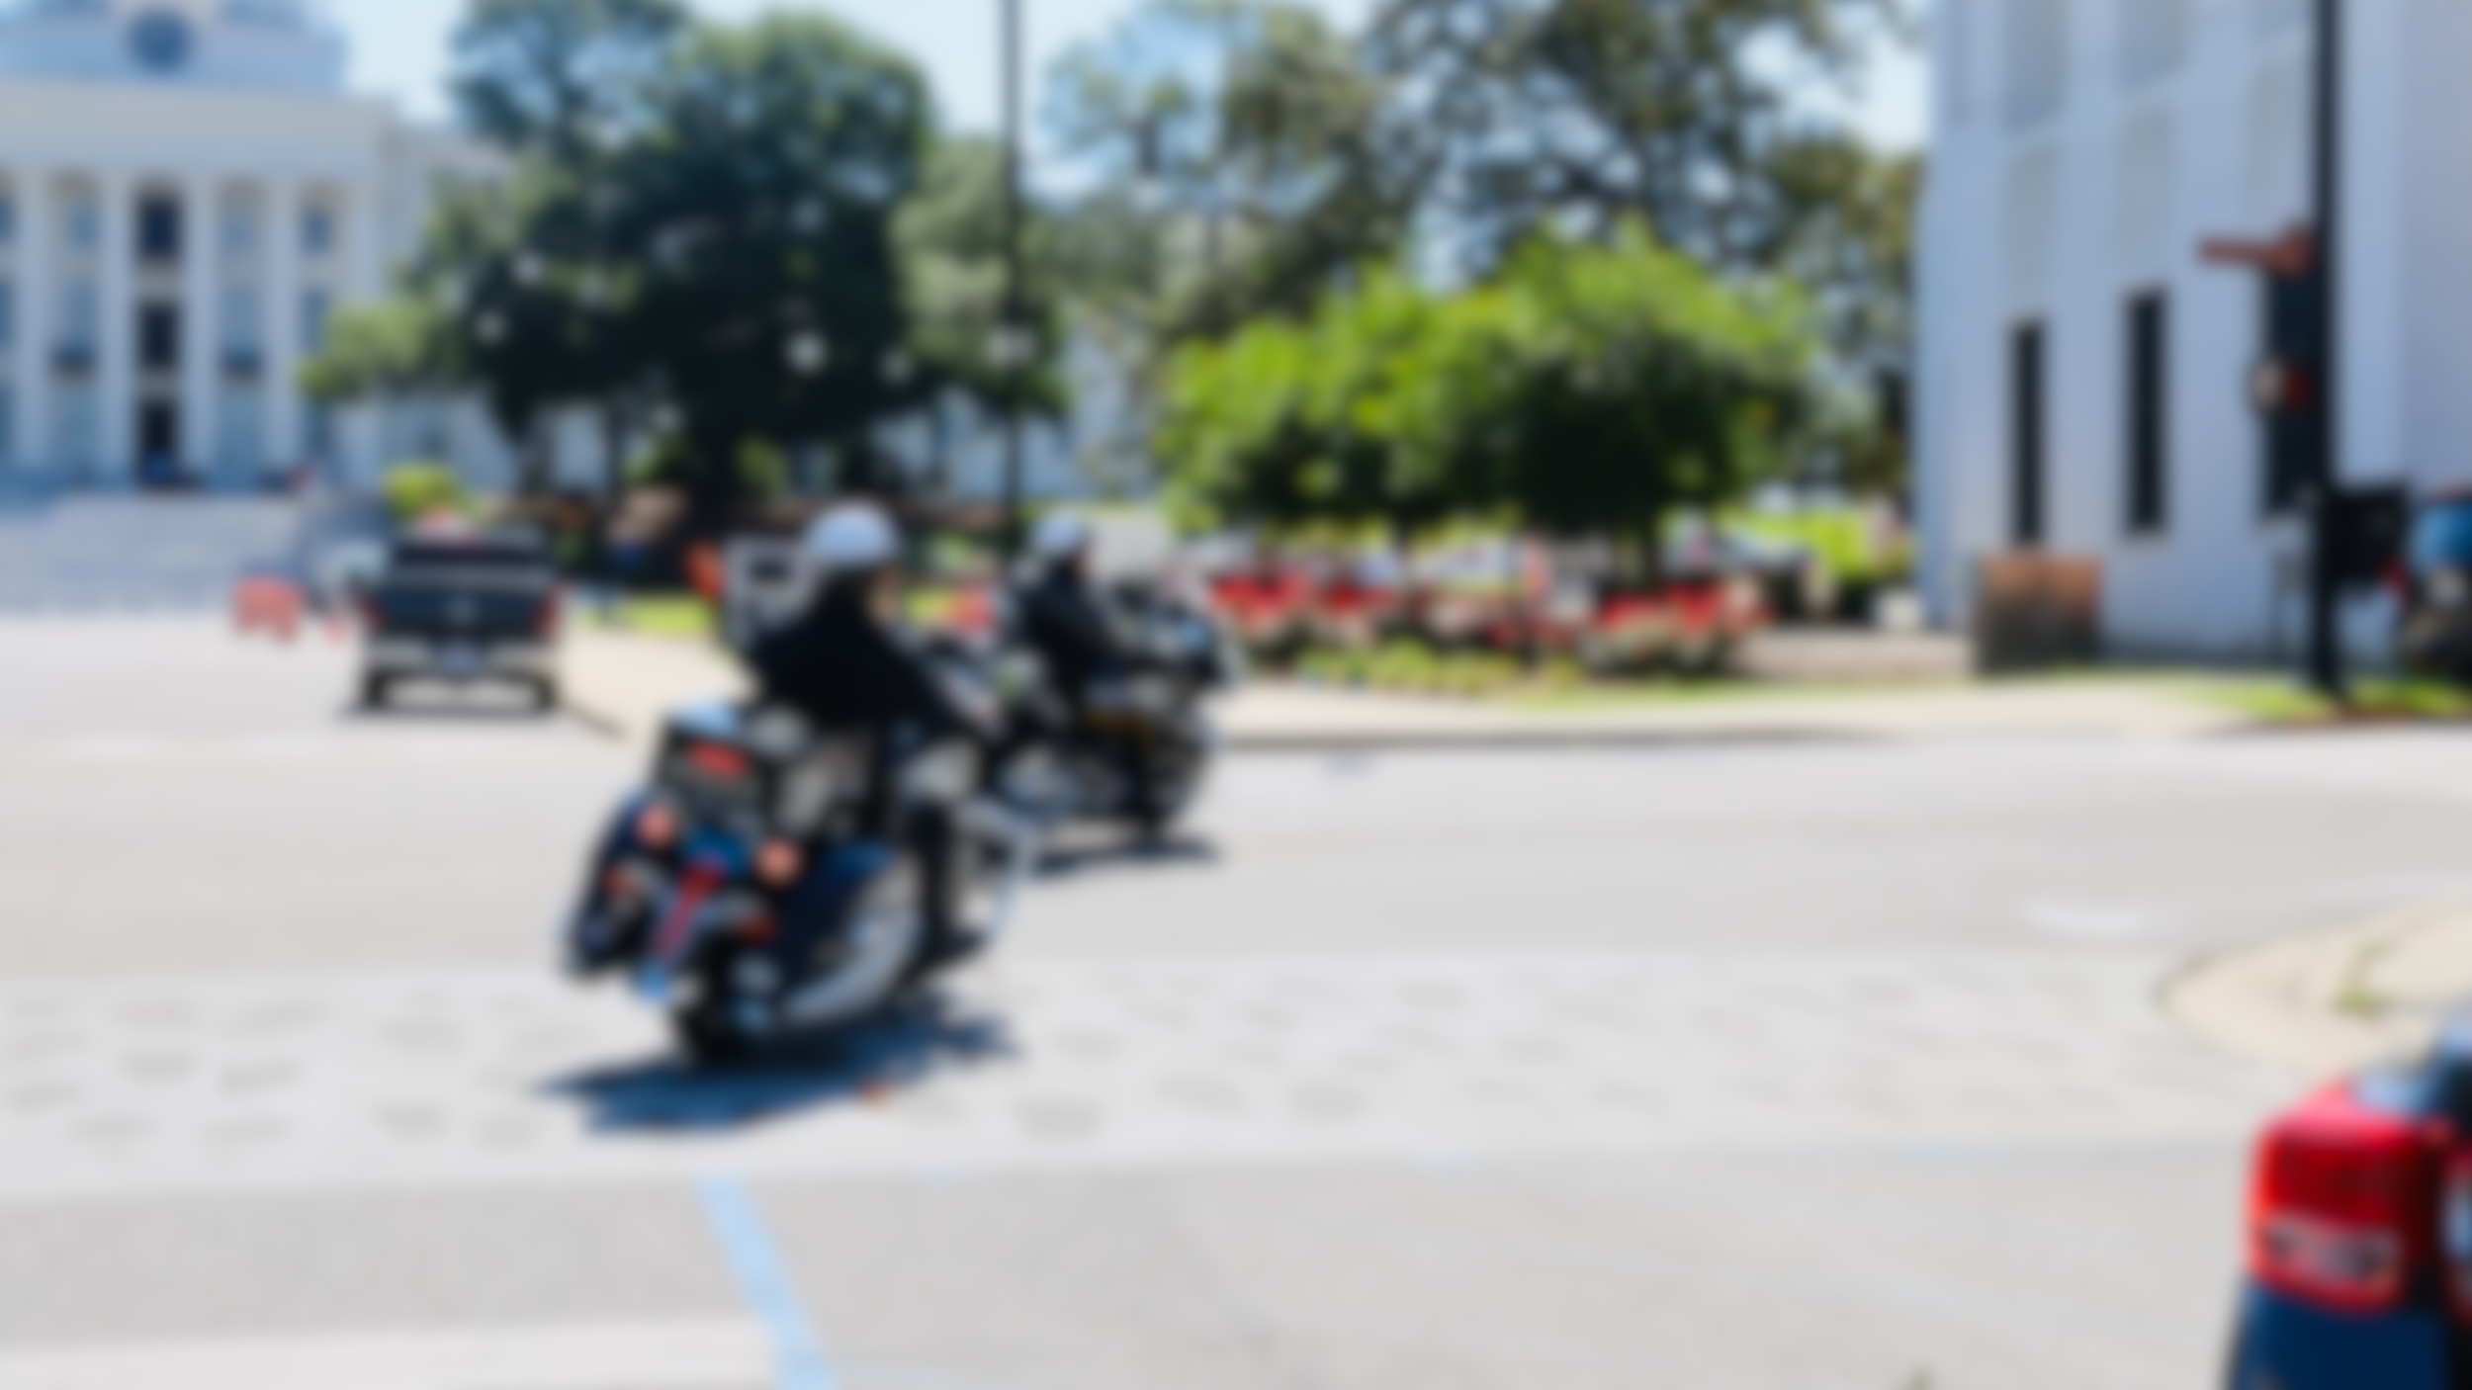
Community Safety Meeting OBJECTIVE
To strengthen our relationship and partnership with the community.

Slide 3
Community Safety Meeting BECAUSE…
Our effectiveness directly correlates with quality of the relationship/partnership we have with the community. Together, we can decrease the crime rate and make it an even safer city.

Slide 4
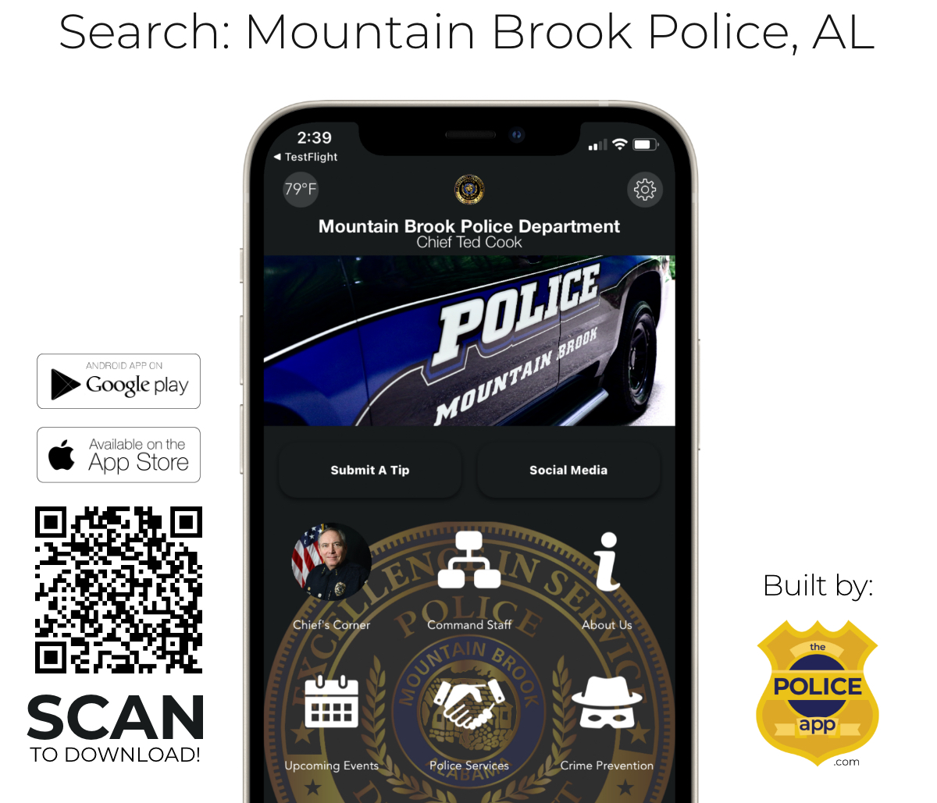
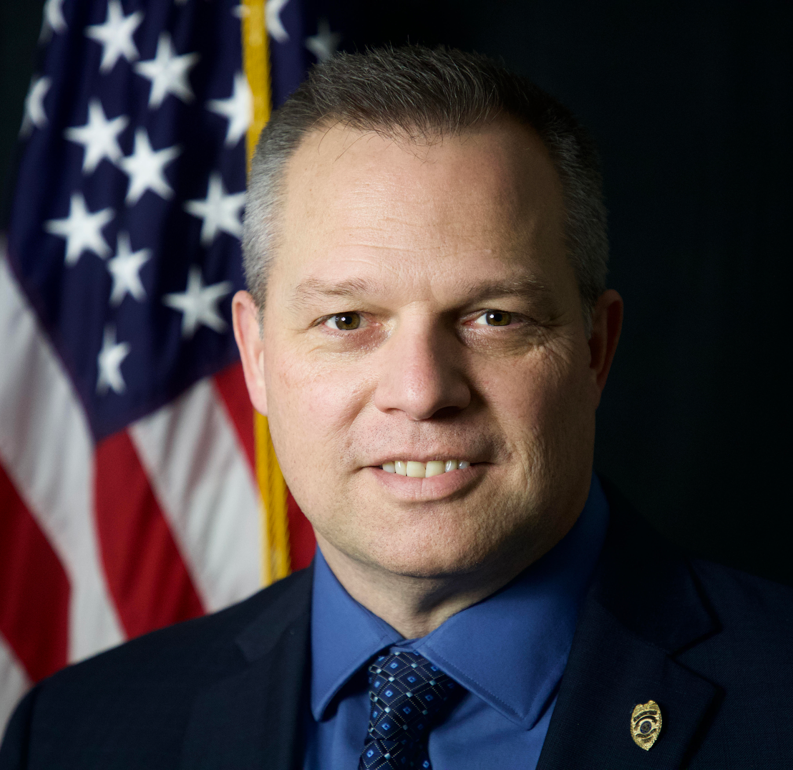

Slide 5
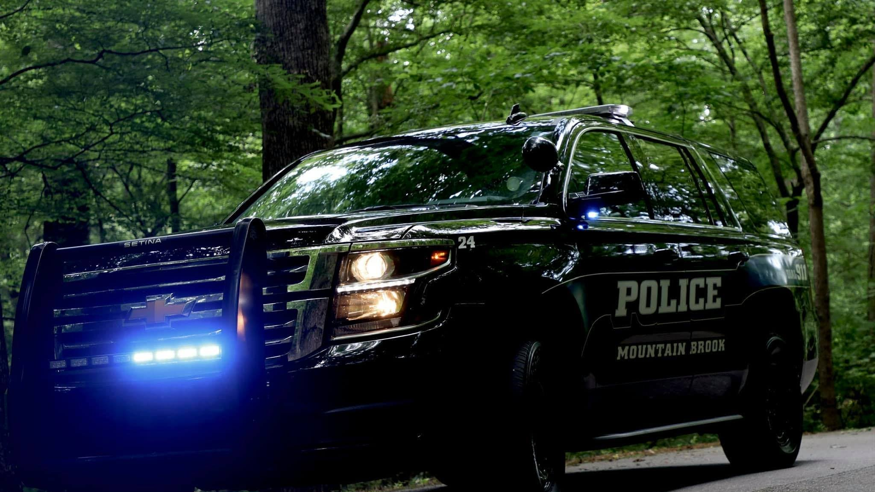
What crimes are occurring in Mountain Brook most frequently?

Slide 6
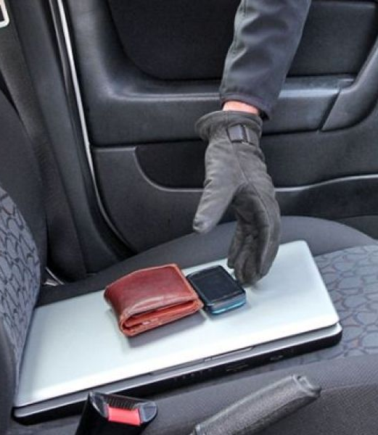
UBEV’s
Unlawful Breaking and Entering a Vehicle

Slide 7
UBEV’s
Unlawful Breaking and Entering a Vehicle
Mostly happening during the night and early morning hours.
Breaking and Entering is often times a misnomer. Most offenses are non-forcible, meaning car doors were left unlocked.
Don’t leave valuables in your vehicle if at all possible. If you have to leave them in your vehicle, secure them in the trunk, console, or glove compartment.

Slide 8
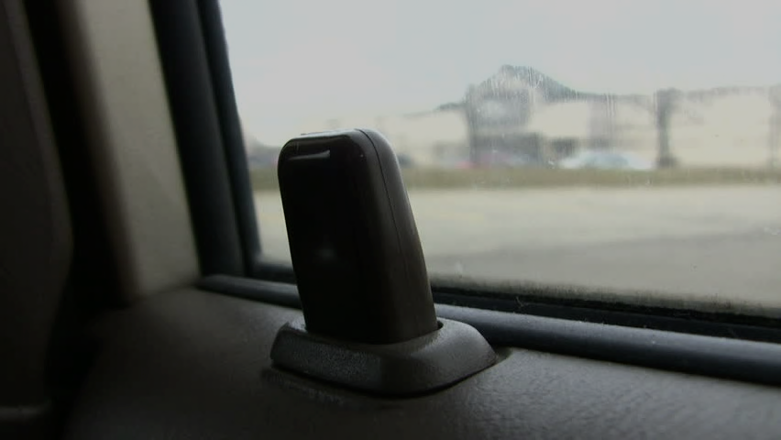
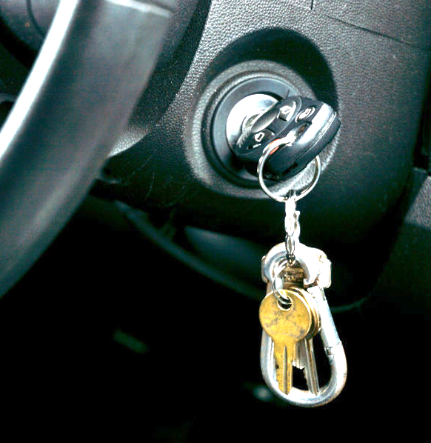
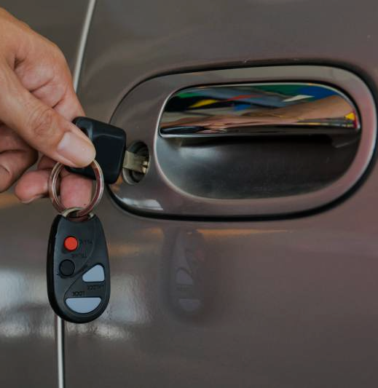
Failure to lock car doors at night has become a nationwide epidemic. Look at any law enforcement social media page, and you’ll see a 9 PM Routine Reminder.
Don’t ever leave your keys or key fob in the car
LOCK YOUR CAR

Slide 9
Park in a well-lit area.

Slide 10
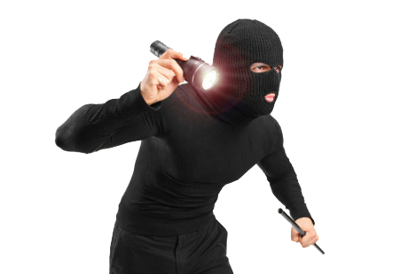
If you observe someone inside of your vehicle, do not attempt to confront them. Instead, get a clothing description from a safe distance, and call the police.

Slide 11
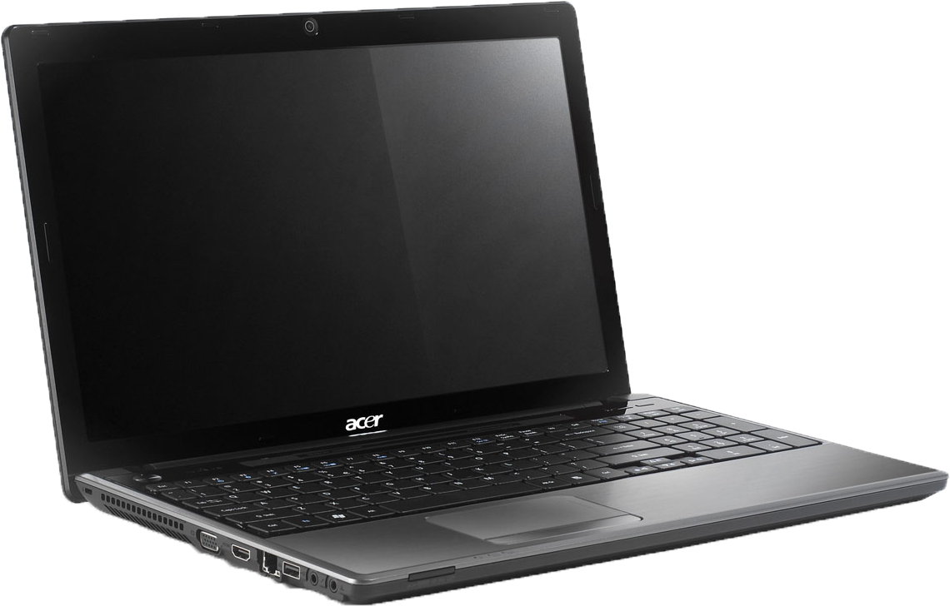
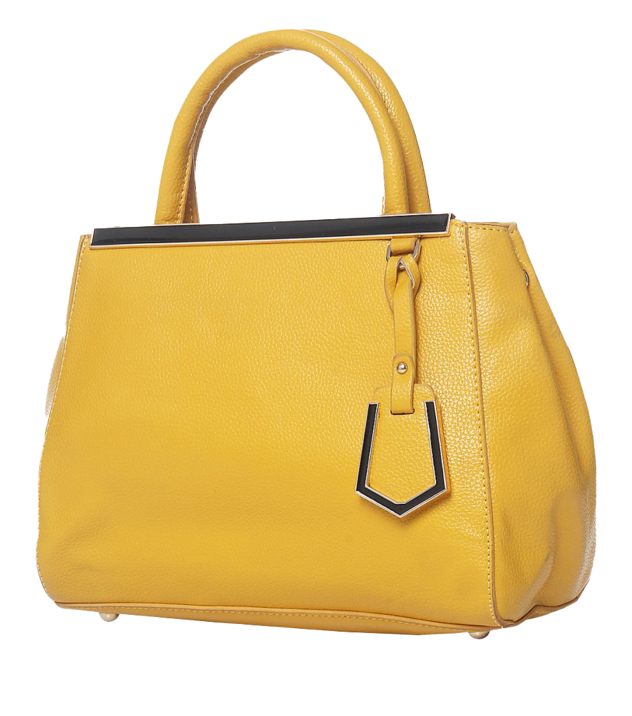
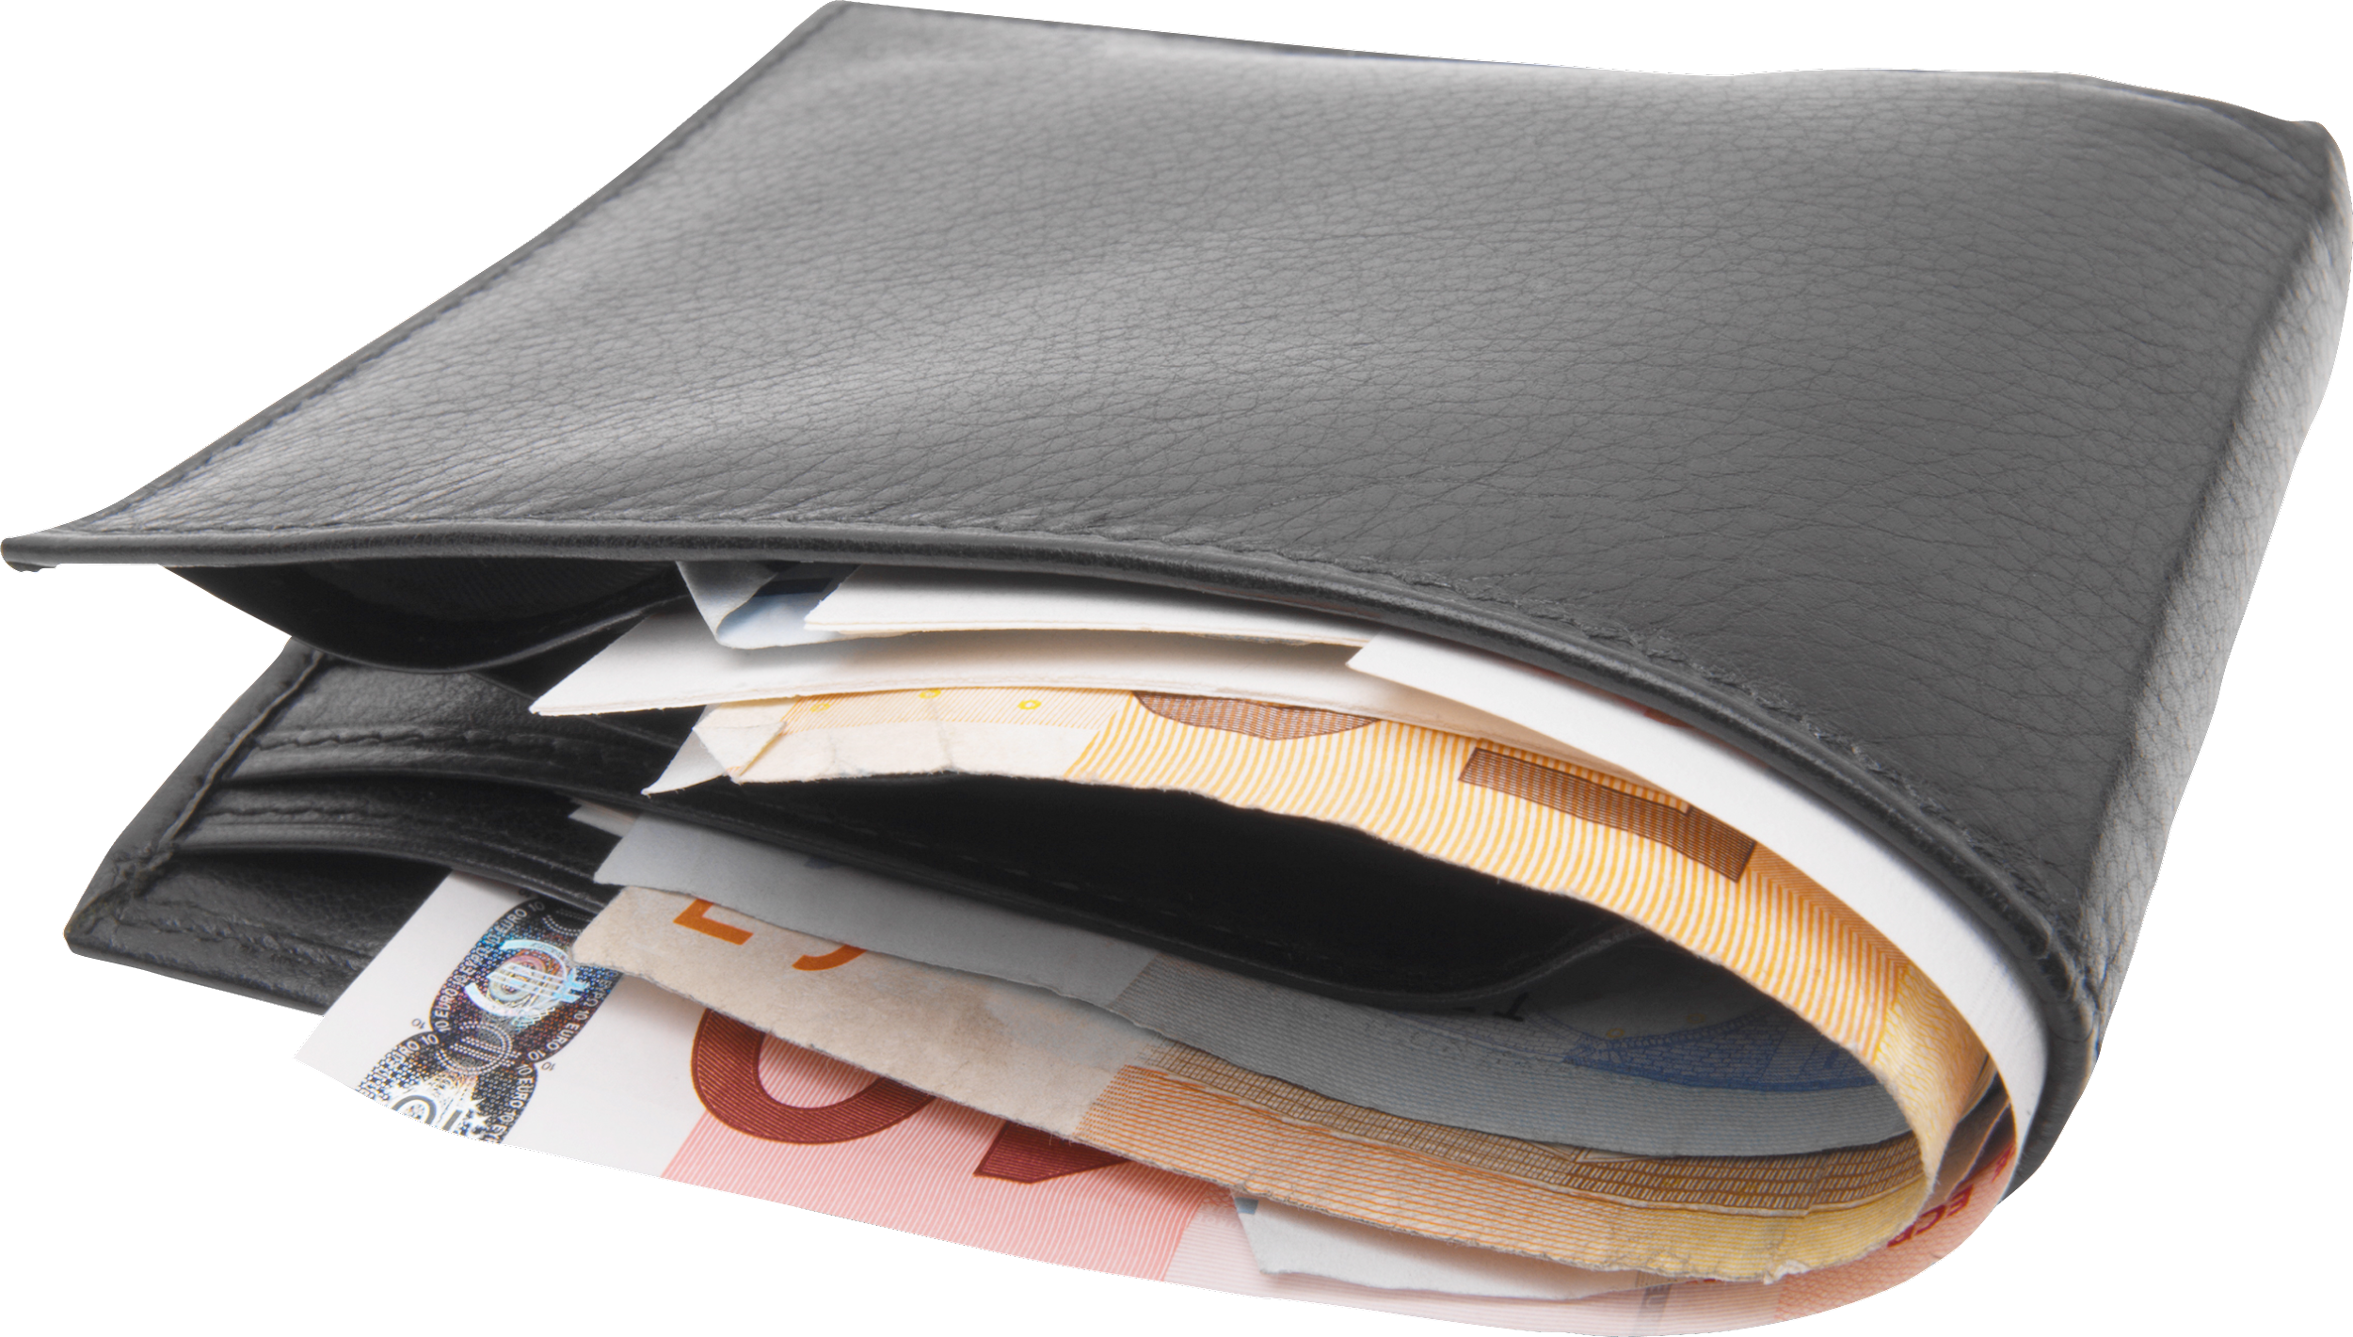
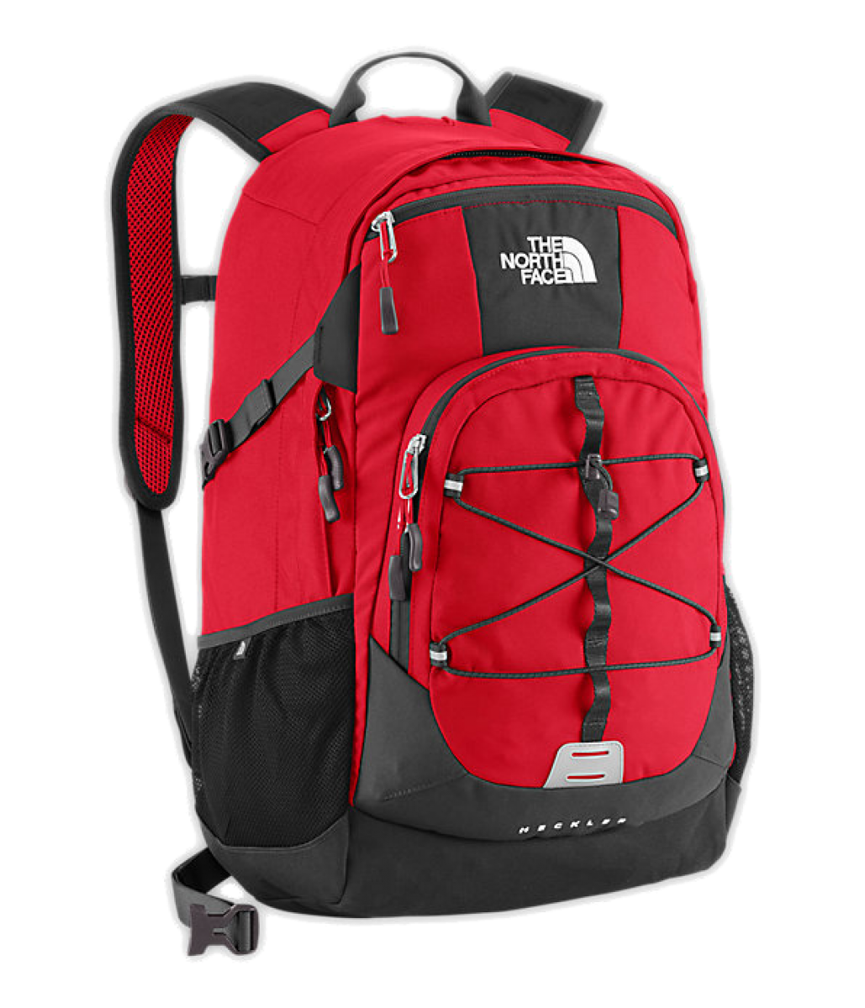
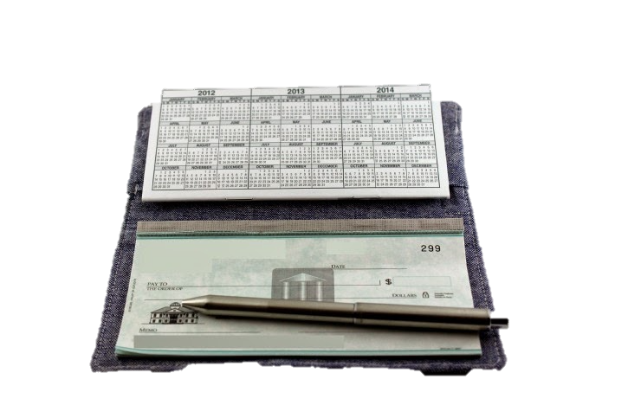
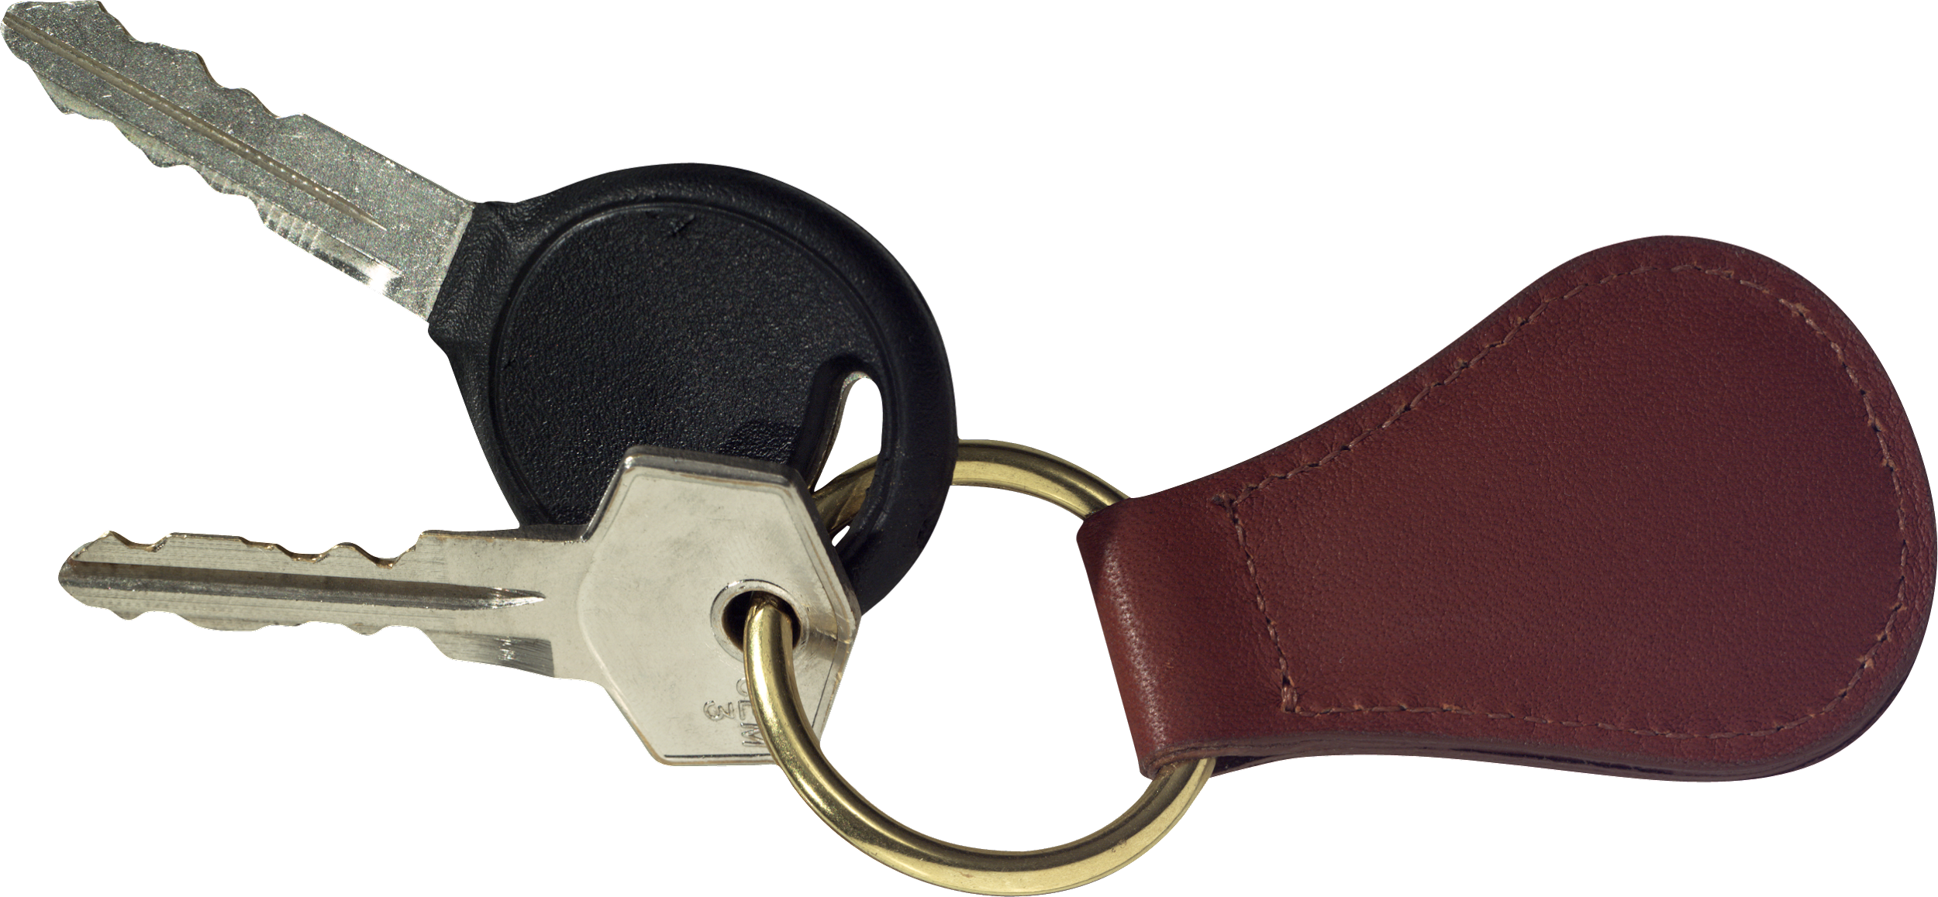
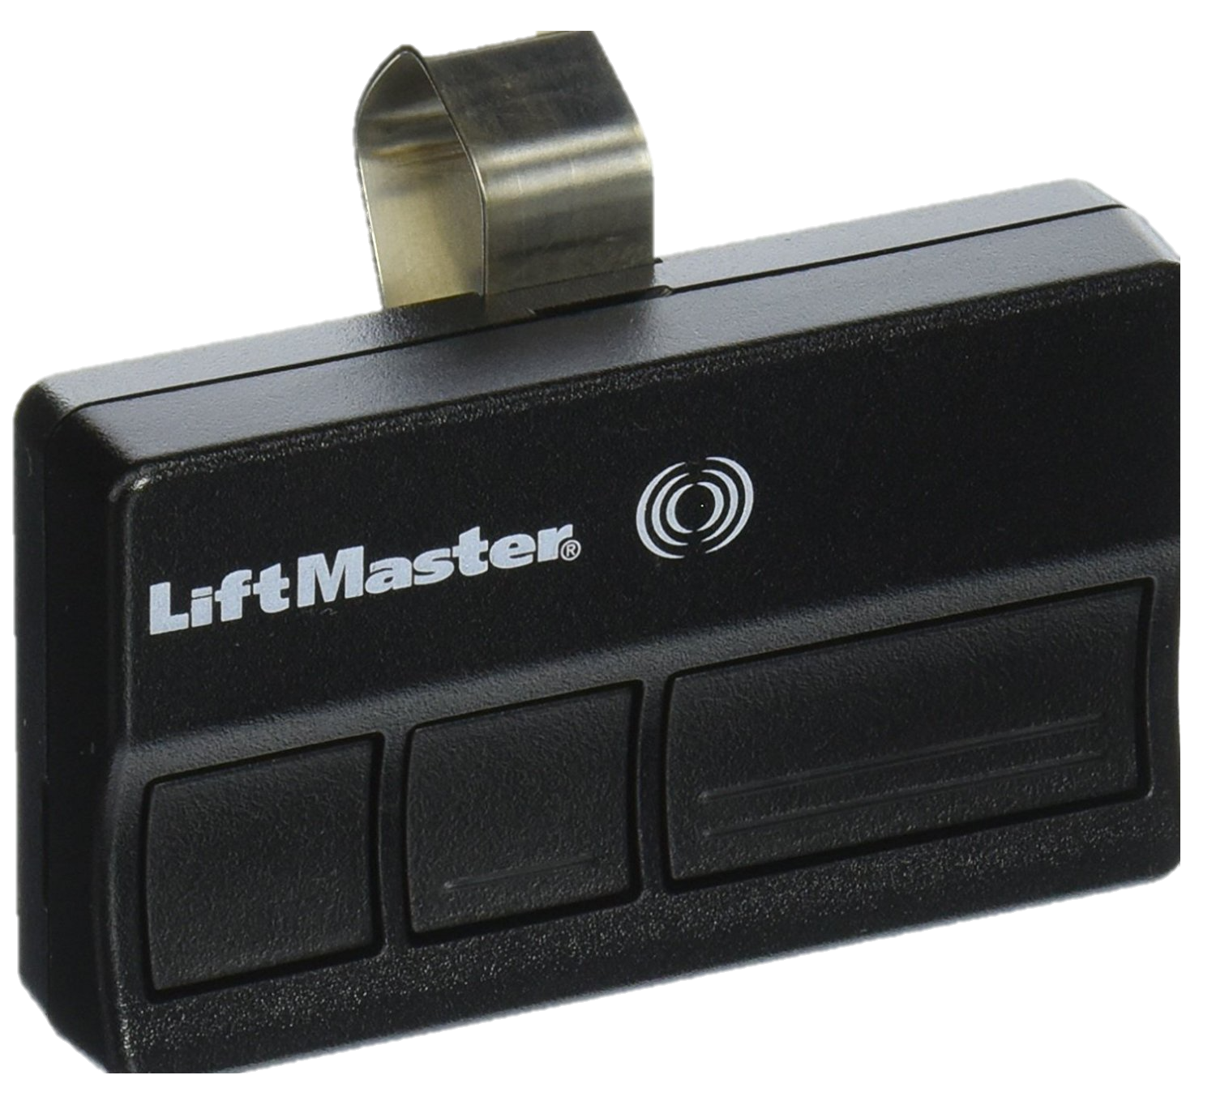
Items Typically Stolen:
Purses, Wallets, Laptops, Backpacks, Currency, Checkbooks, Car Keys, and Firearms

Slide 12
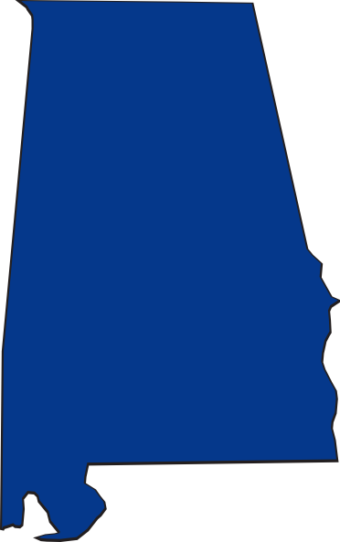
Alabama is in the top 10 states for the highest number of guns stolen from both gun stores and private owners.
A survey conducted by the DOJ says that offenders
predominantly get guns from one of two sources, via theft or from family members and or friends.
The BPD Police Chief said last year that most of the guns they recover have been stolen out of someone’s vehicle and that by the time they recover it, it’s already been used in the commission of a crime.

Slide 13
BURGLARIES

Slide 14
BURGLARIES
Residential Burglaries most commonly occur during the day.
Business Burglaries most commonly occur after hours.

Slide 15
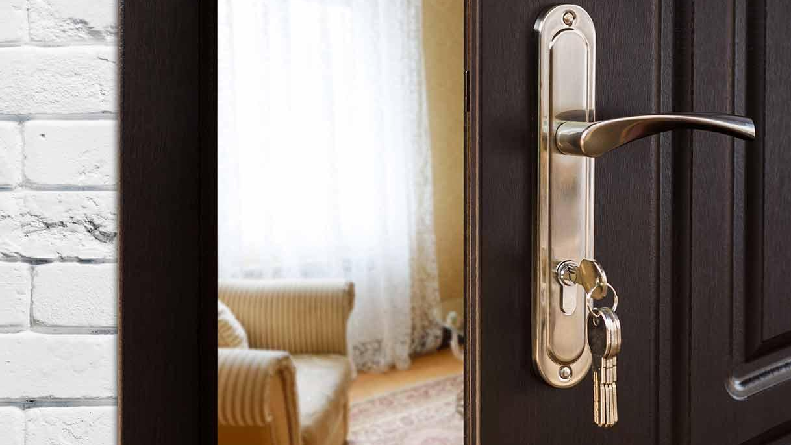
Keep your doors and windows locked while away from home.

Slide 16
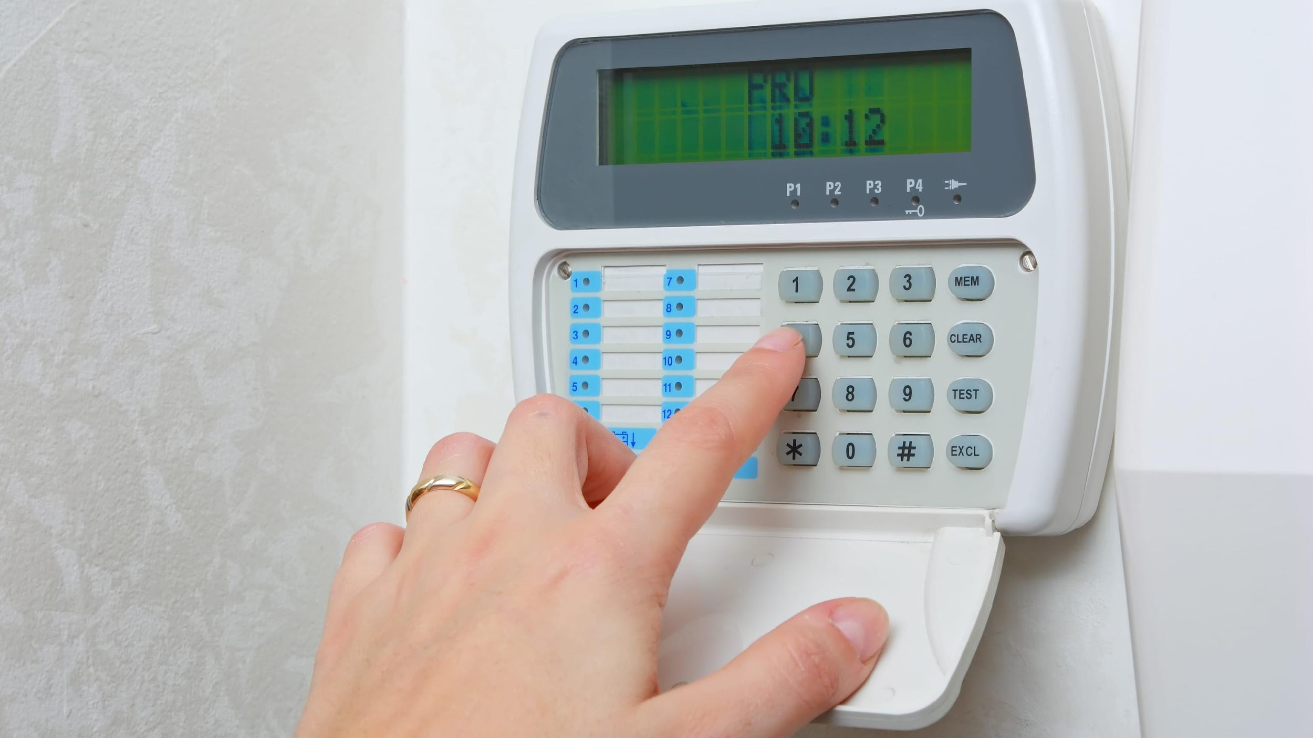
Keep your alarm activated.

Slide 17
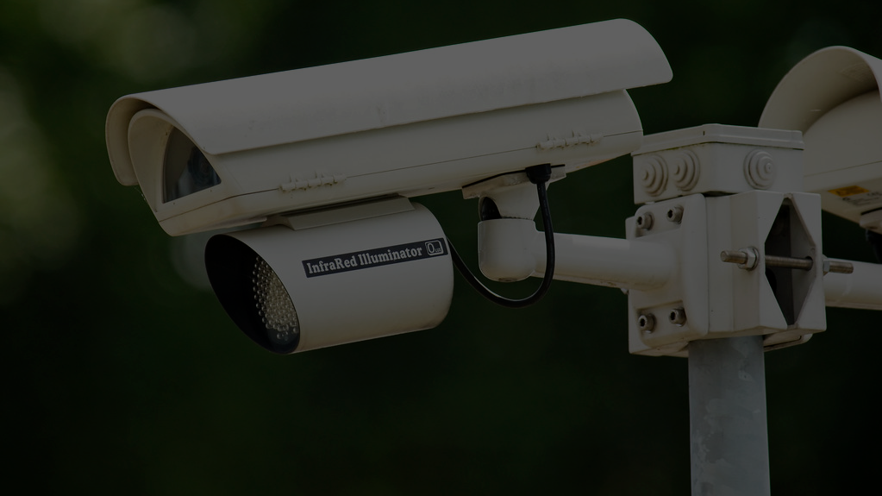
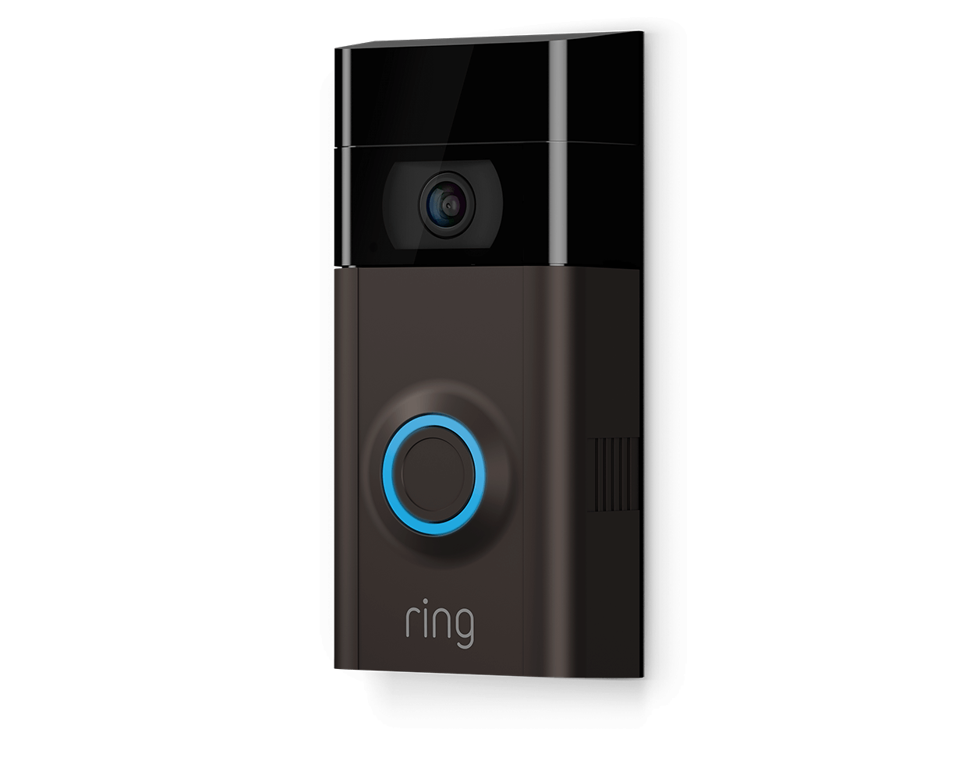
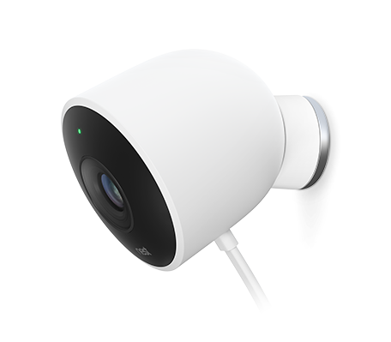
Consider purchasing surveillance cameras (canvassing).

Slide 18
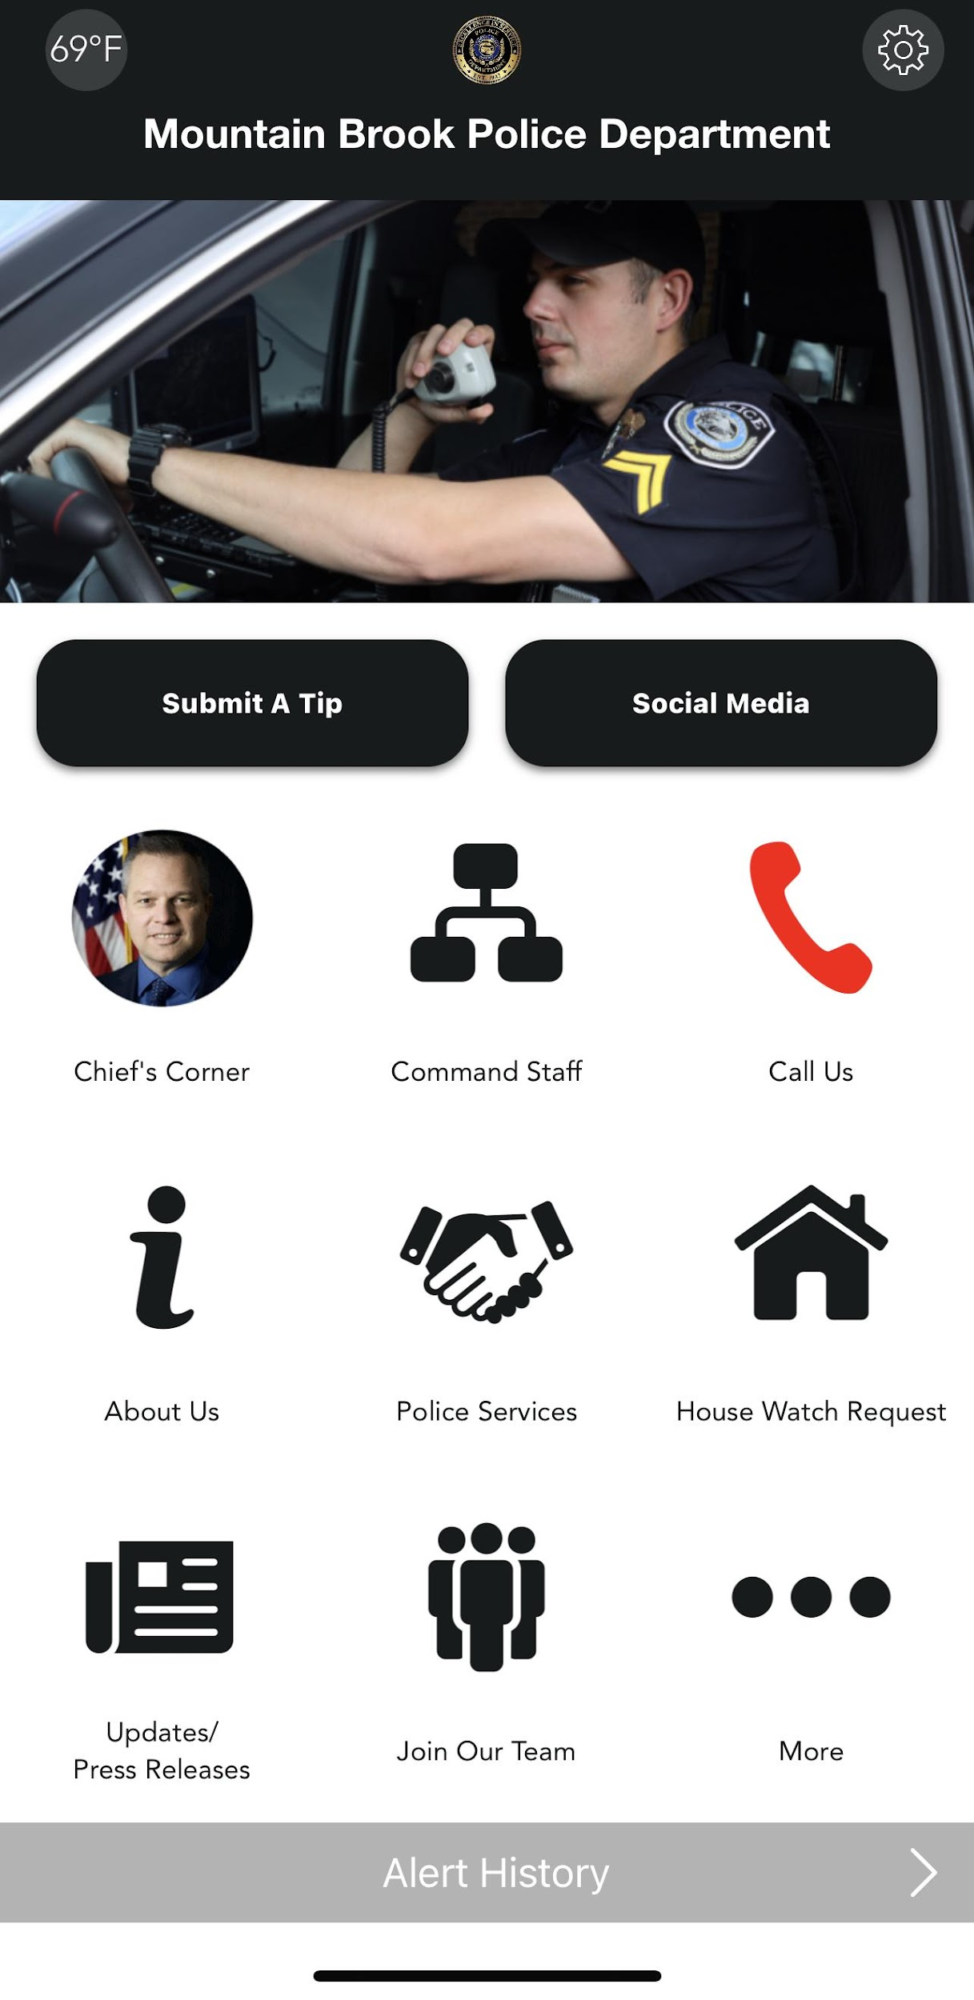
When you vacation, have your house put on the house watch list.

Slide 19
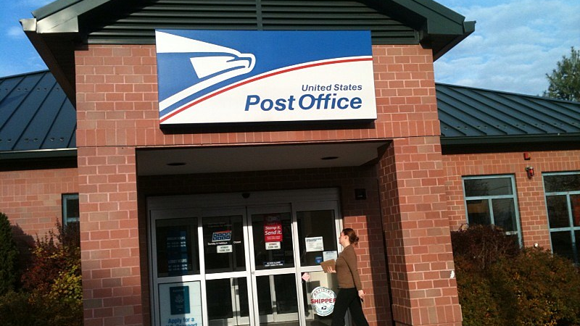
Have your mail held at the Post Office.

Slide 20
Don’t advertise on Social Media that you’ll be gone.

Slide 21
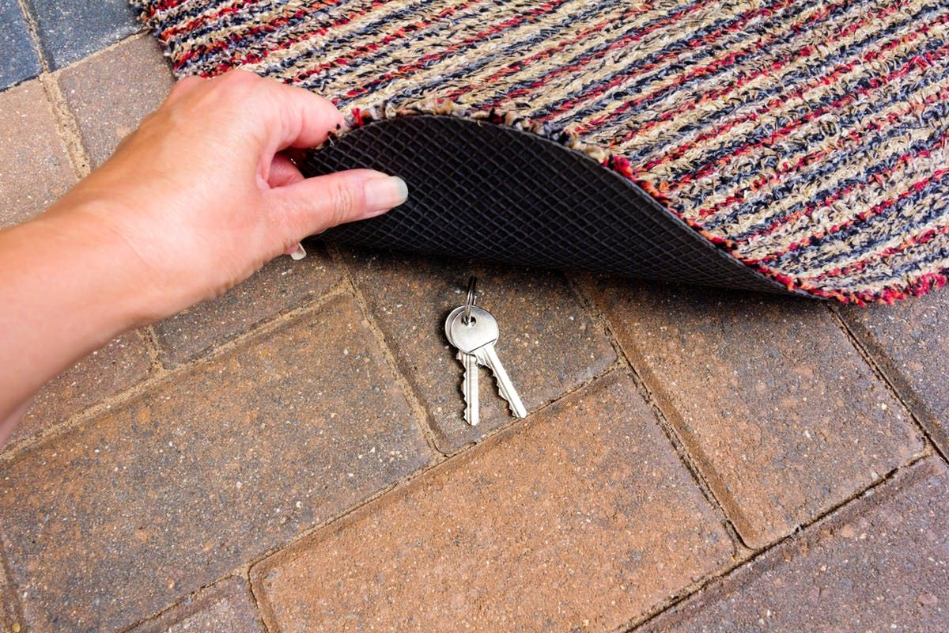
Don’t hide your keys.

Slide 22
Use exterior lighting as a deterrent.

Slide 23
Consider placing your interior lights on a timer to give the impression you’re at home.

Slide 24
You know your neighborhood better than anyone. If you see something that’s not right, call us.

Slide 25
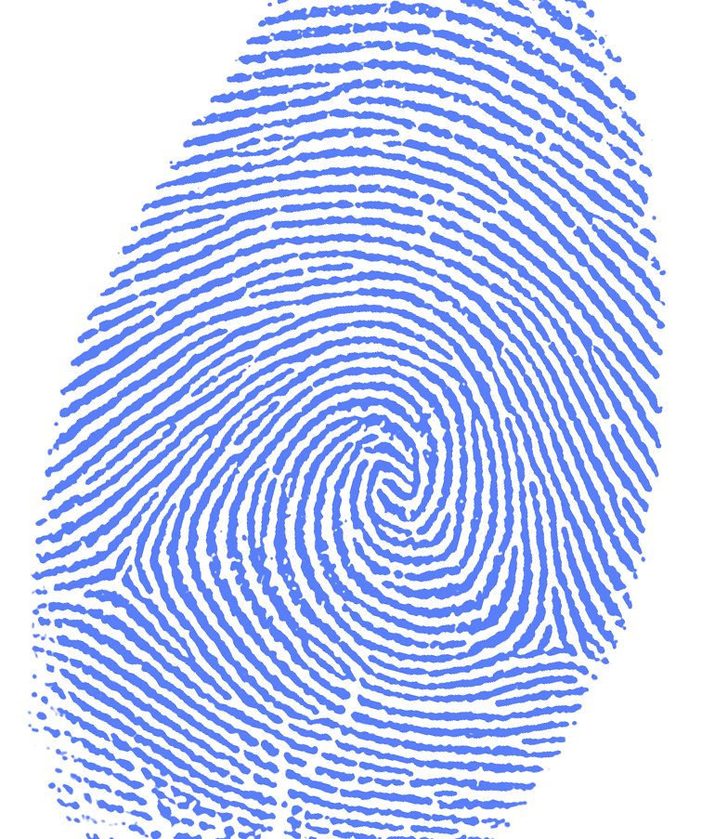
THEFT

Slide 26
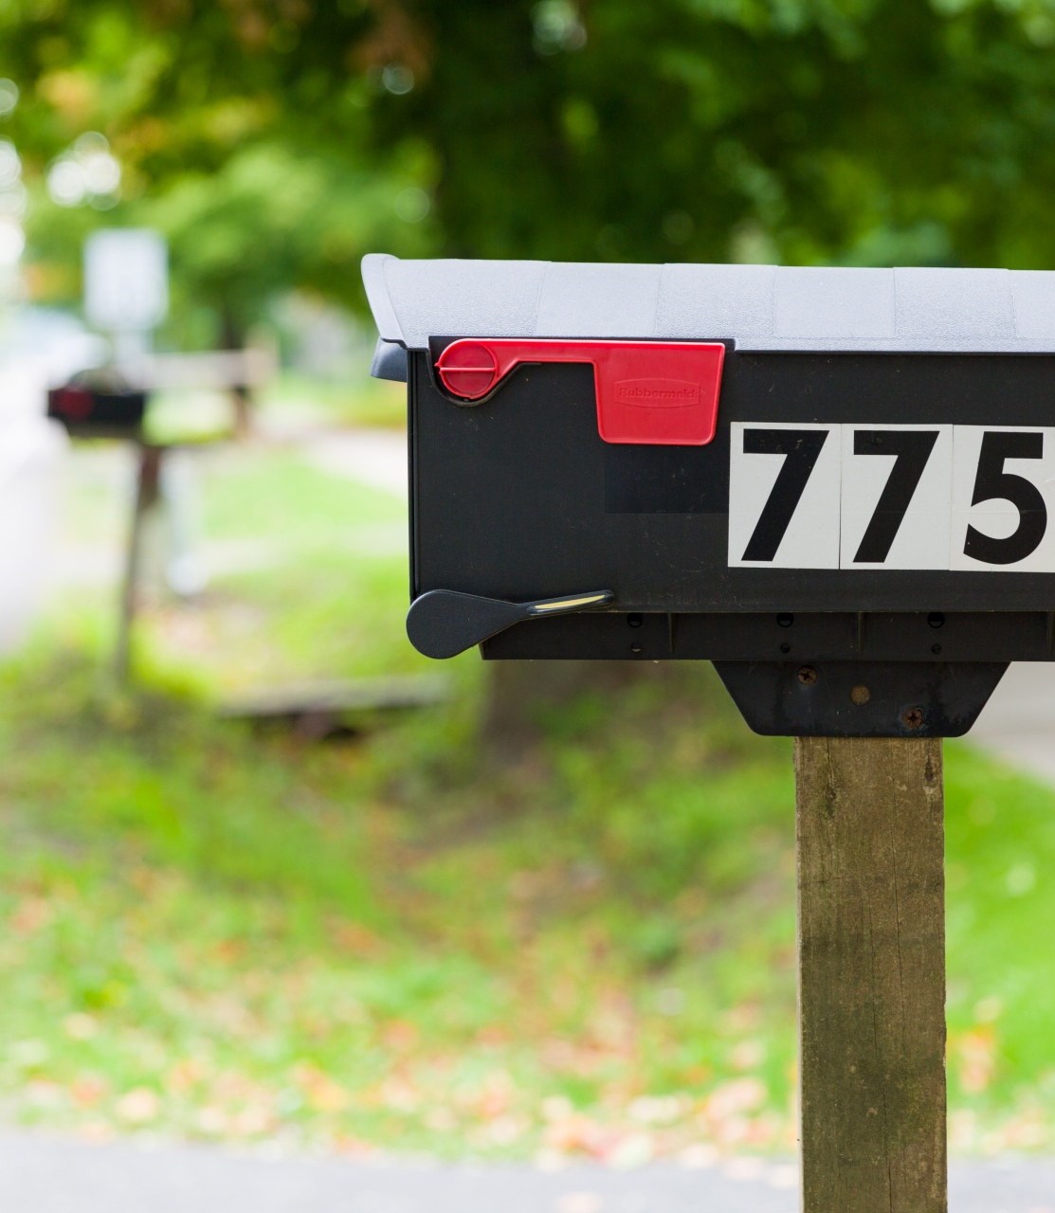
Mailbox Theft/Fraudulent Checks
Don’t mail checks or other sensitive documents via your mailbox or via the large blue exterior Post Office mailboxes.
Take them inside the Post Office and drop them in the interior drop box. Use gel ink pens to write checks.
Consider paying bills online.

Slide 27
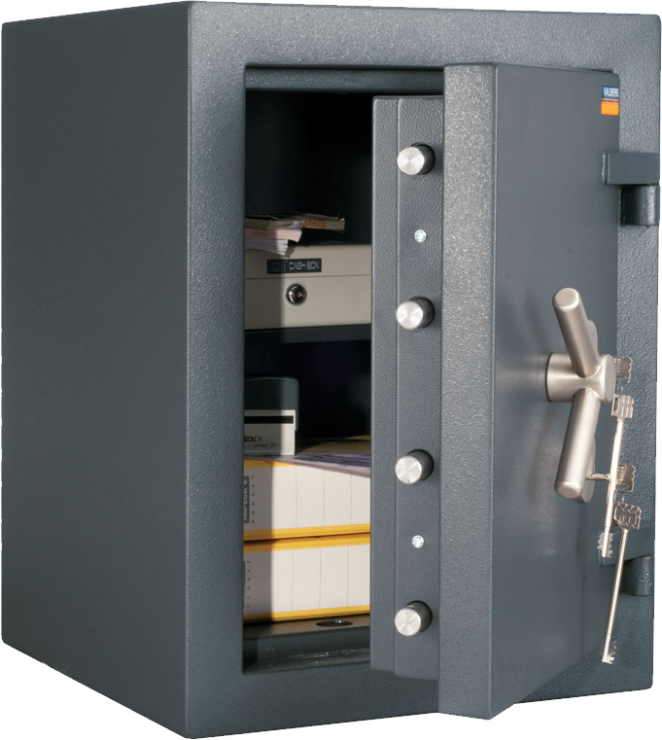
Keep valuables in a secure location such as a properly
mounted floor safe.
Consider using a safety deposit box.
Burglaries are difficult to solve.

Slide 28
Keep a list of serial numbers for when applicable.
Keep an inventory of valuables with pictures and descriptions.
This will help with property recovery following a theft.

Slide 29
Keep financial documents out of plain sight when having others inside your home.
Limit access to your home, personal information, and property by contract workers.
This also includes caregivers and cleaning services.

Slide 30
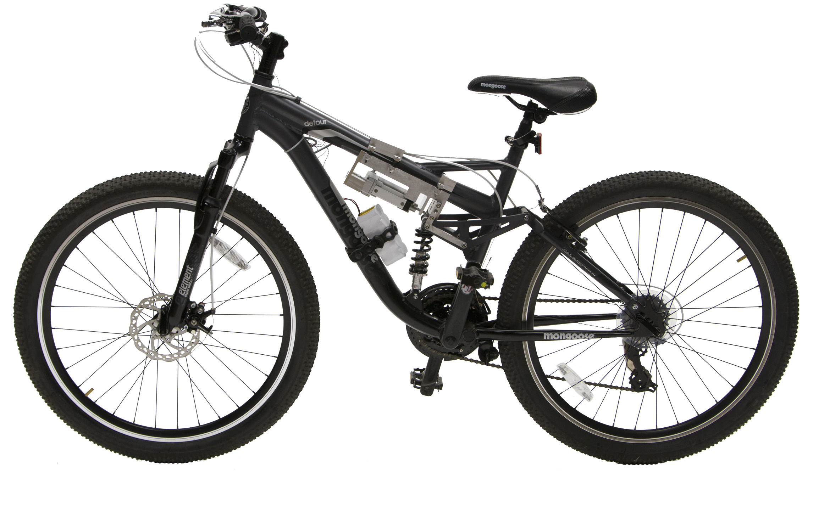
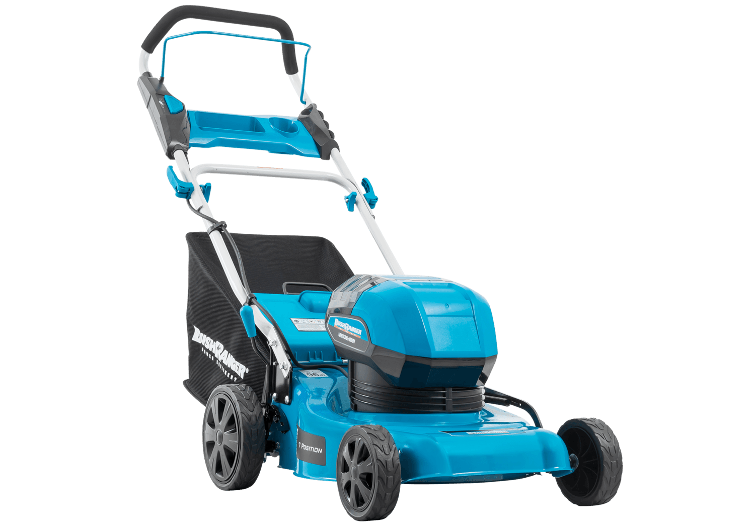
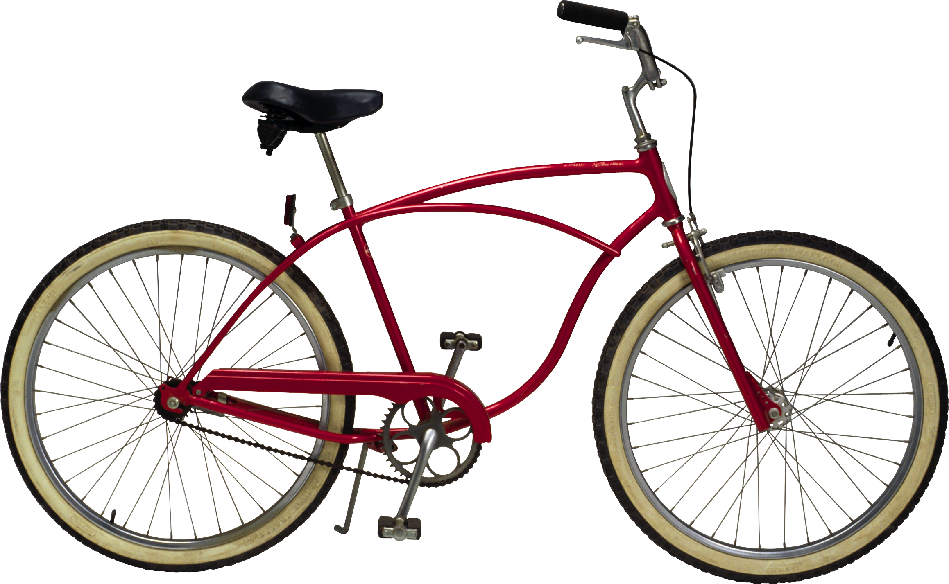
Don’t leave lawn equipment or bicycles outside.

Slide 31
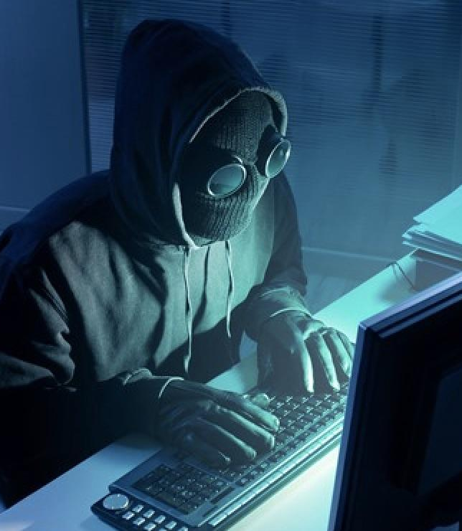
IDENTITY
THEFT

Slide 32
IDENTITY
THEFT
Chances are high that your personal identifying information has been exposed or stolen already.
143 million Americans had sensitive personal information exposed during a data breach of Equifax in 2017. It’s become a matter of when instead of if your information will be compromised.
However, it’s still important to safeguard our personal information.

Slide 33
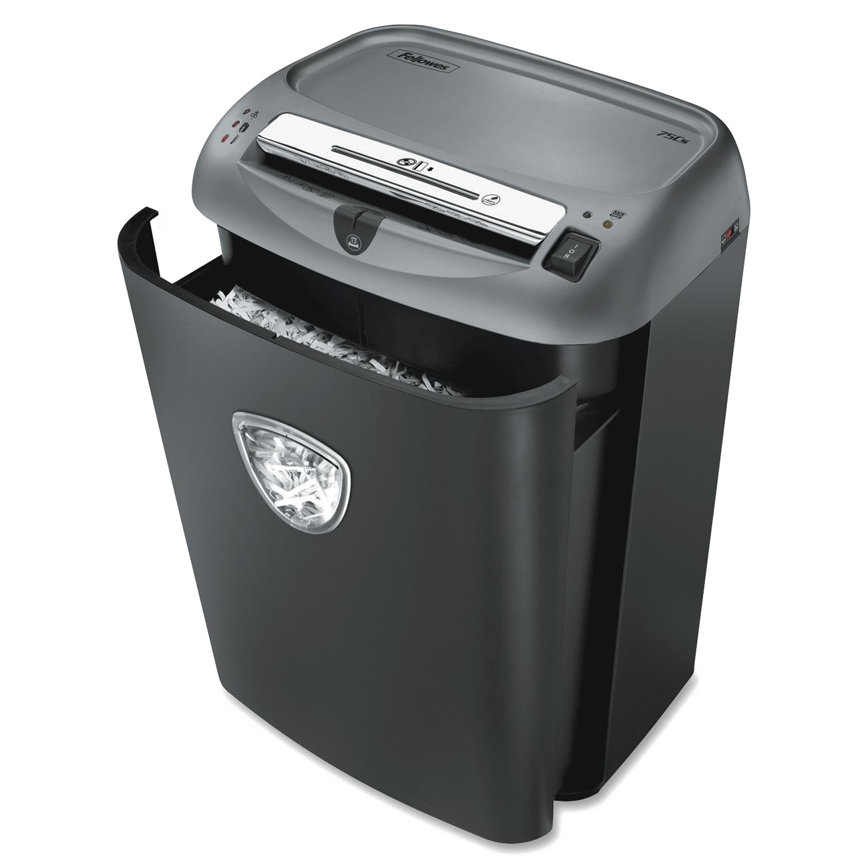
Shred bank statements and credit card statements.

Slide 34
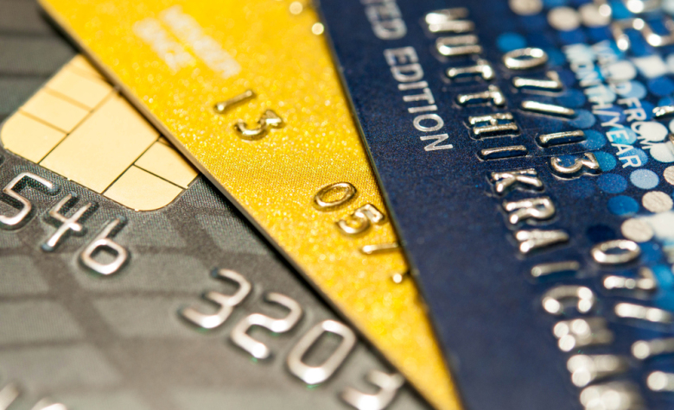
Shred credit card offers and opt out of them by visiting www.optoutprescreen.com

Slide 35
Monitor bank accounts for fraudulent transactions. Some
banks have apps you can use to monitor transaction
history, cancel a stolen debit card and request a new one.

Slide 36
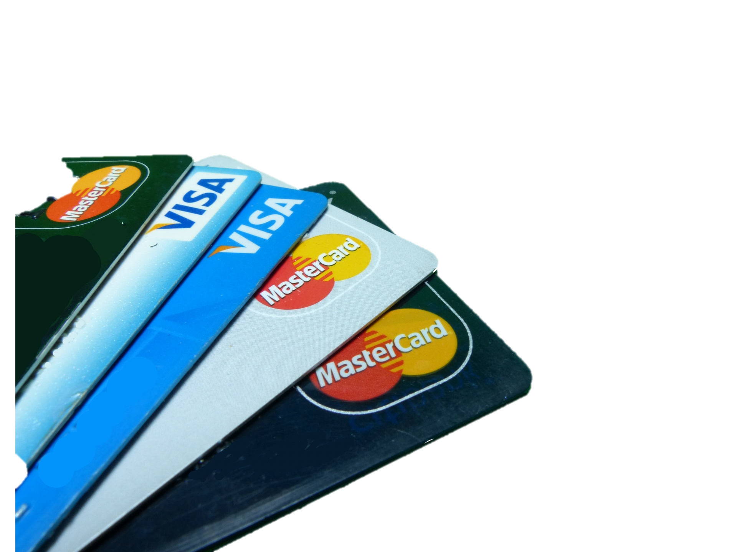
Use credit cards at restaurants and gas pumps as opposed to debit cards.
Check your credit report at least once per year by visiting www.annualcreditreport.com.
Only shop online with companies you know.
Keep personal information private and passwords secure.
Use two-factor and multi-factor authorization whenever possible.

Slide 37
Scams / Phishing

Slide 38
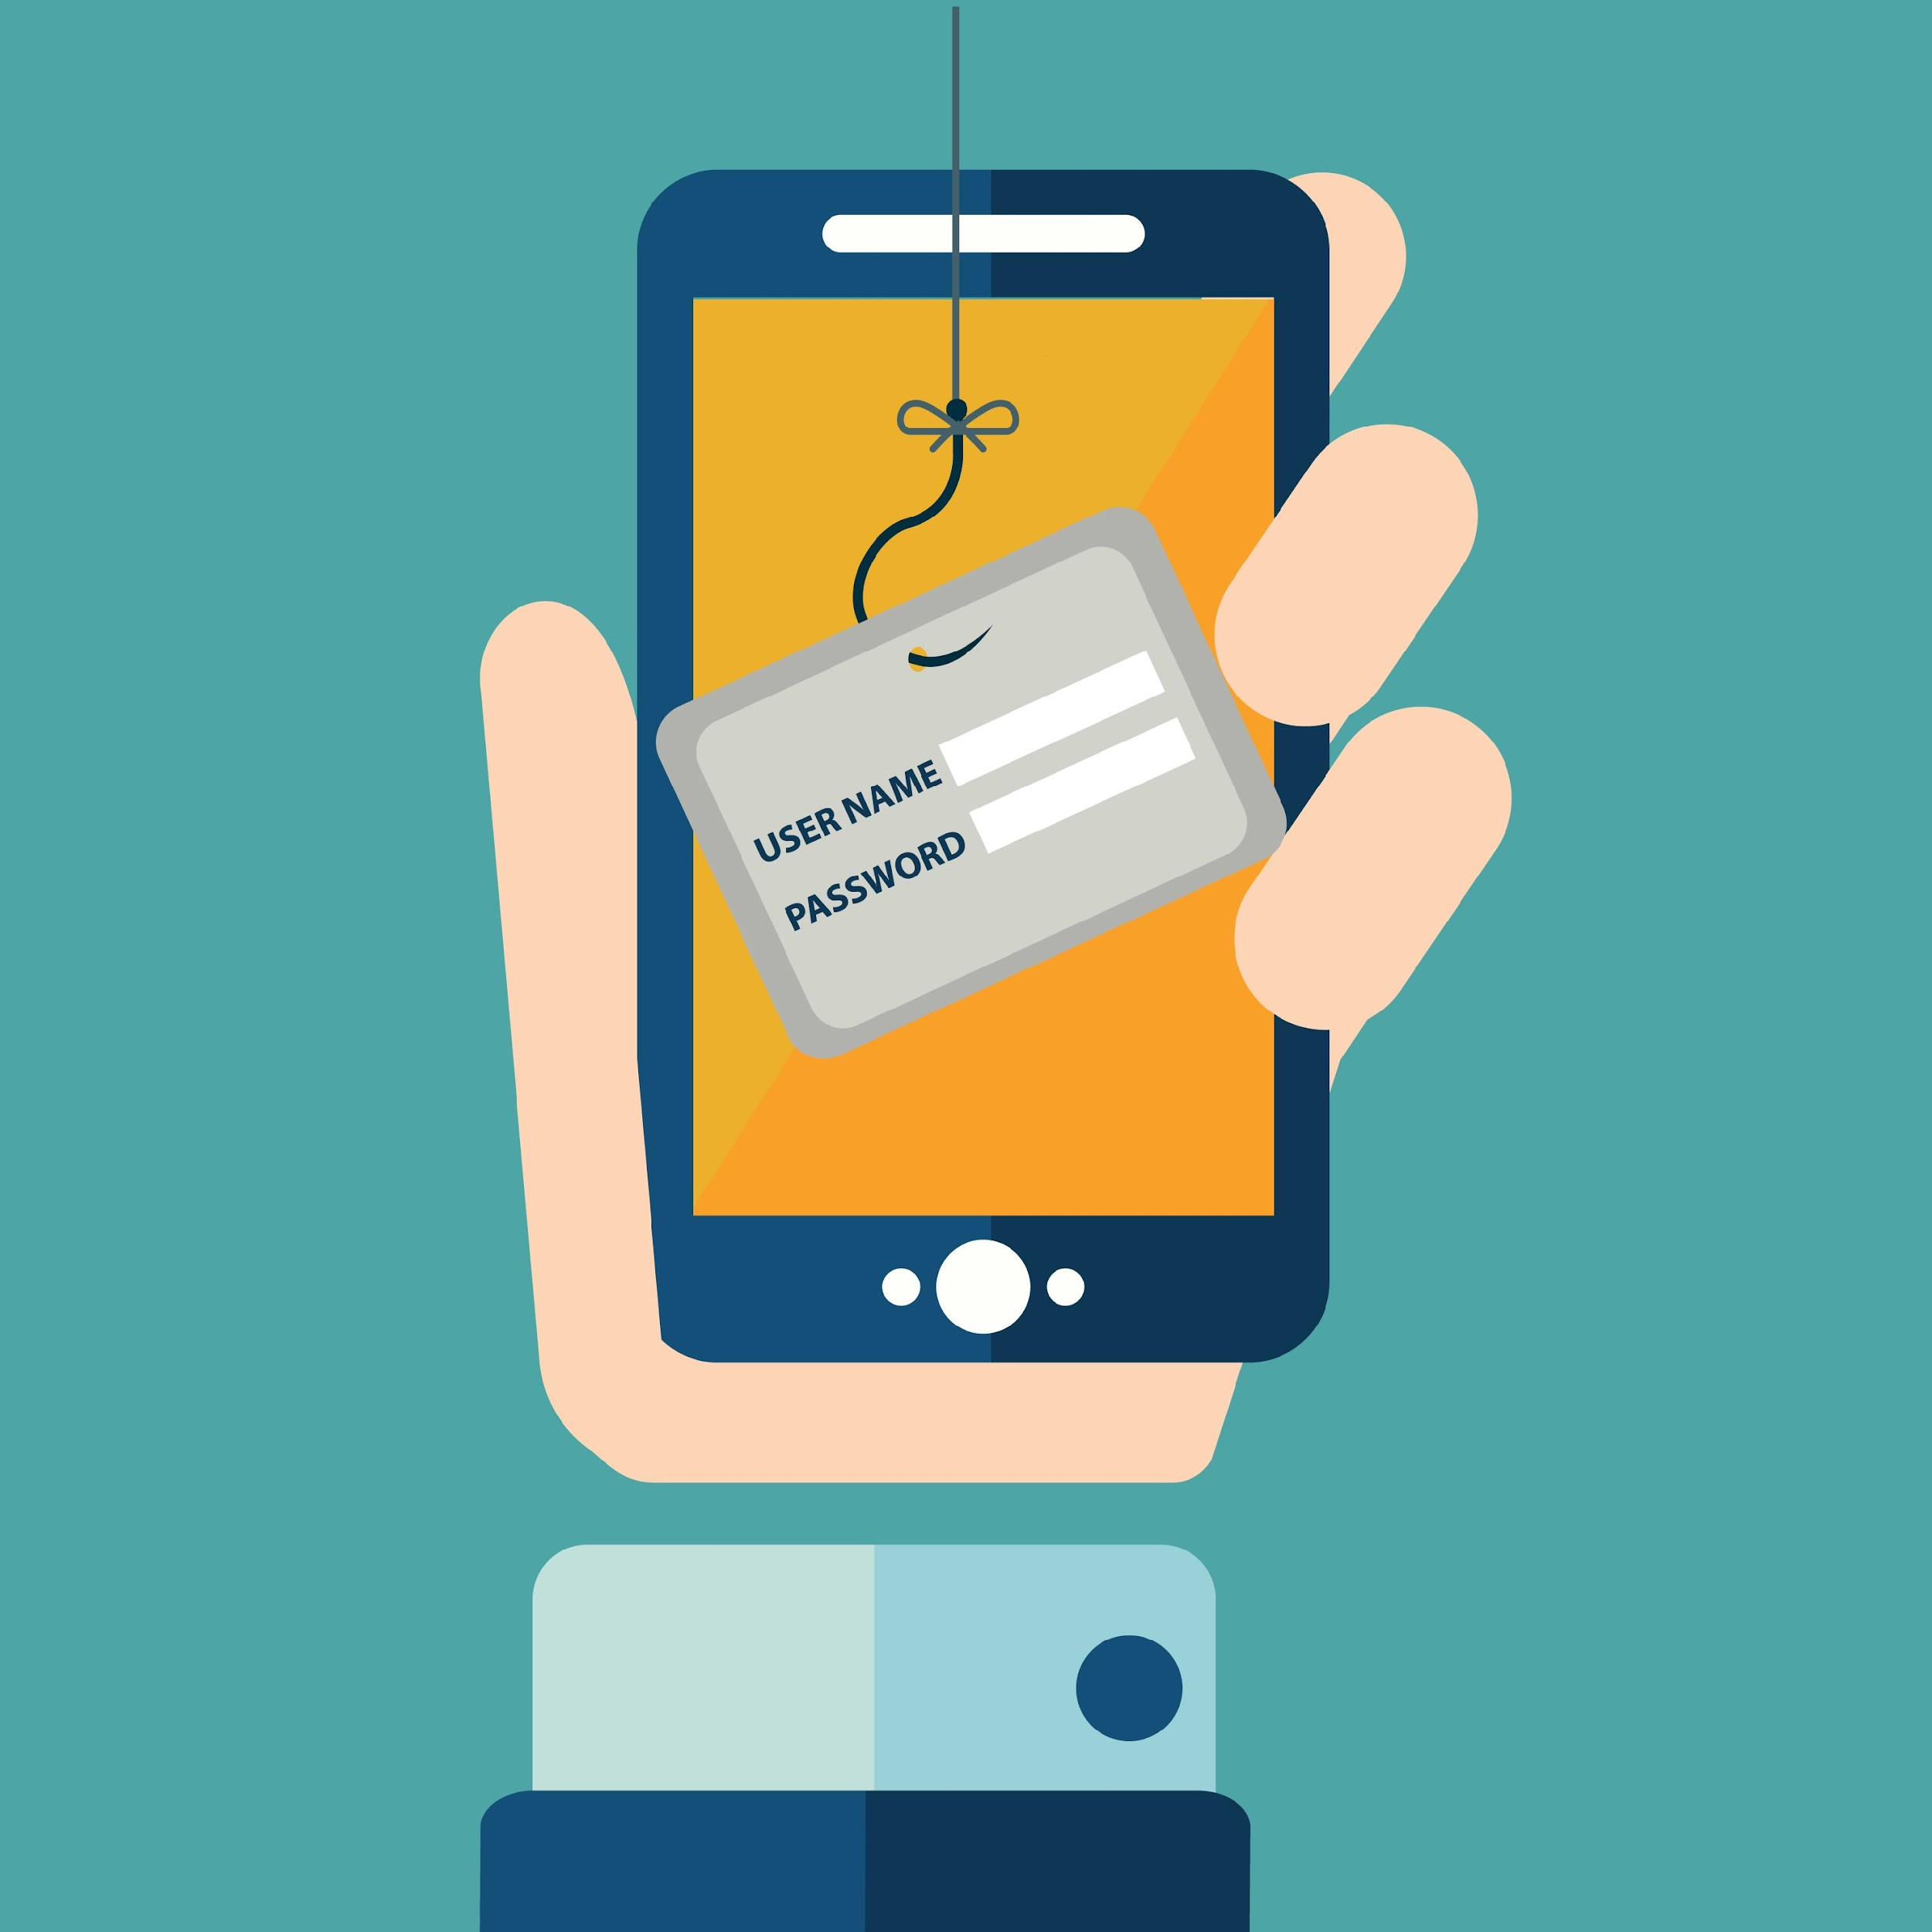
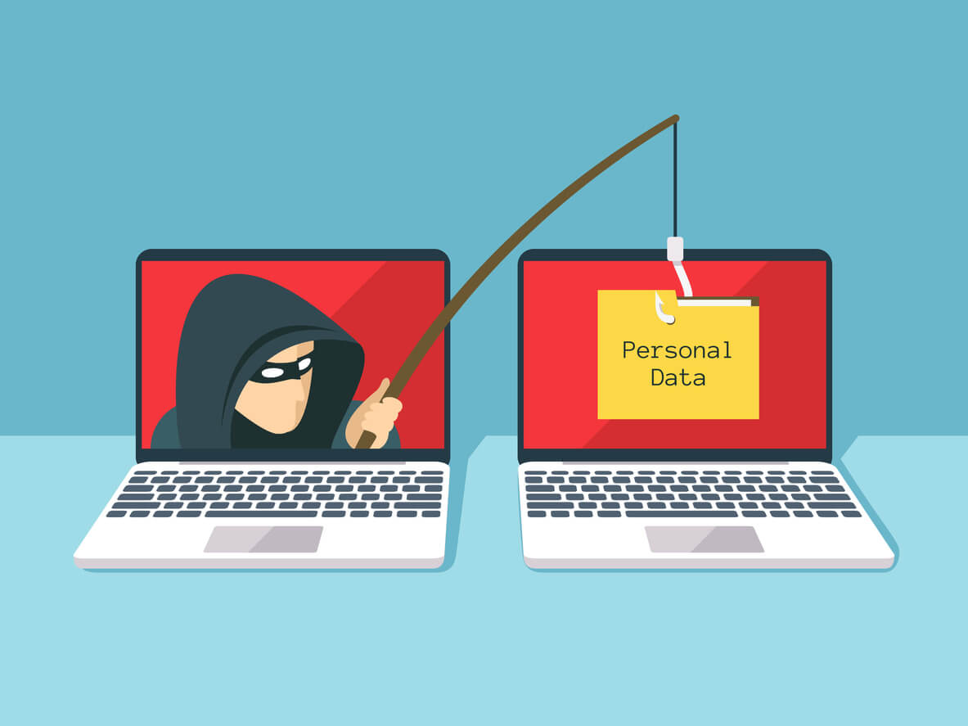
Phishing is when someone pretends to be someone they’re not in order to get your personal / account information.

Slide 39
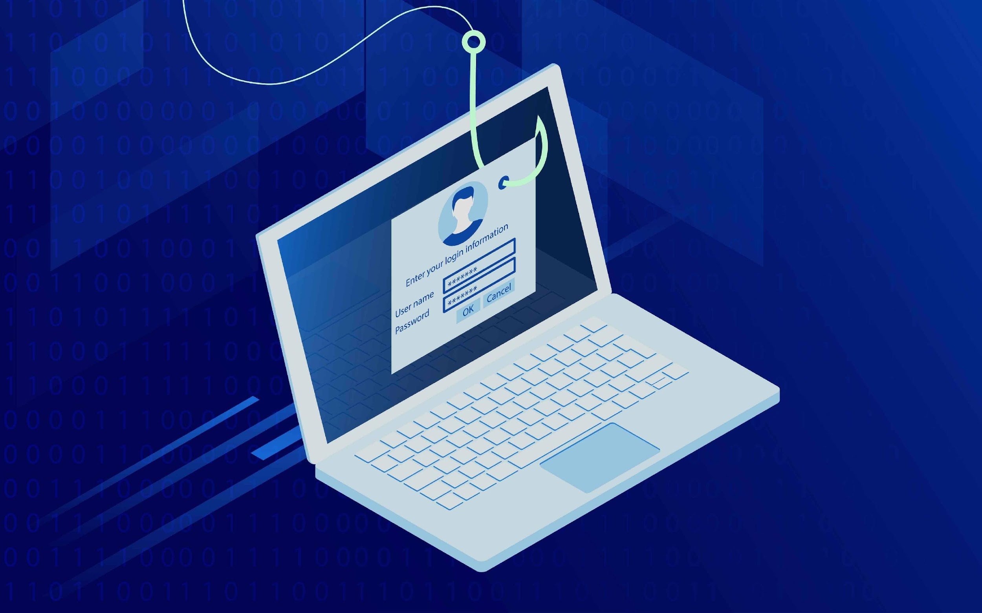
Scammers will use emails, phone calls, text messages, or pop-up messages to trick you into giving them your information. They may try to steal your passwords, account numbers, or social security number. They may trick you into installing software on your computer and gain anything stored therein.

Slide 40
How to identify phishing emails and messages

Slide 41
Phishing emails and text messages may look like they’re from a company you know or trust.
They may look like they’re from a bank, a credit card company, a social networking site, a government agency, an online payment website, app, or online store.

Slide 42
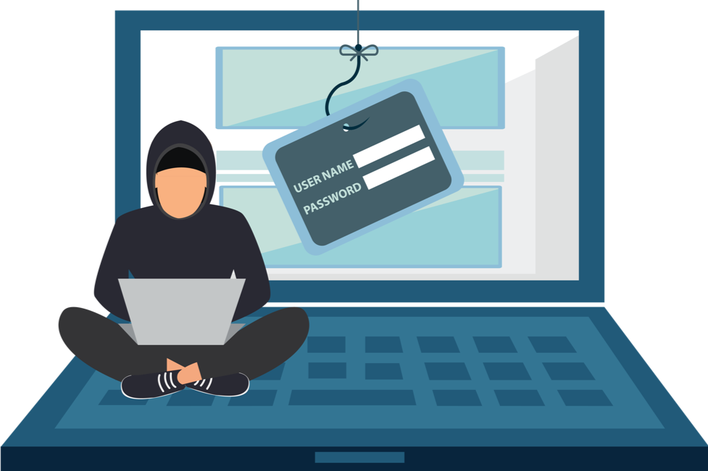
Phishing emails and text messages often tell a story to trick you into clicking on a link or opening an attachment.
They may:*
Say they’ve noticed some suspicious activity or log-in attempts.
Claim there’s a problem with your account or your payment information.
Ask you to confirm some personal information.
Include a fake invoice for payment.
Want you to click on a link to make a payment.
Say you’re eligible to register for a government refund.
Offer a coupon for free stuff.
Tell you there’s a problem with a package delivery.

Slide 43
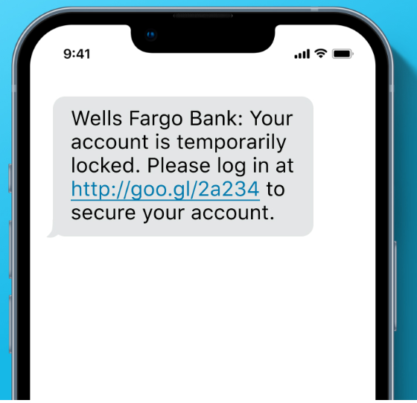
Common Characteristics
Fake messages, pop-ups and emails vary in form and content but there are some key guidelines to identify scams.

Slide 44
The request is completely random, unprompted and has no connection to you or any activity you’ve undertaken.
The message has a sense of urgency. An action must be taken in order to avoid a negative consequence.
Fake emails and messages can sometimes be identified by poor grammar, misspelled words and awkward use of language.
The emails and messages may address you in generic terms such as, “Dear Subscriber”.

Slide 45
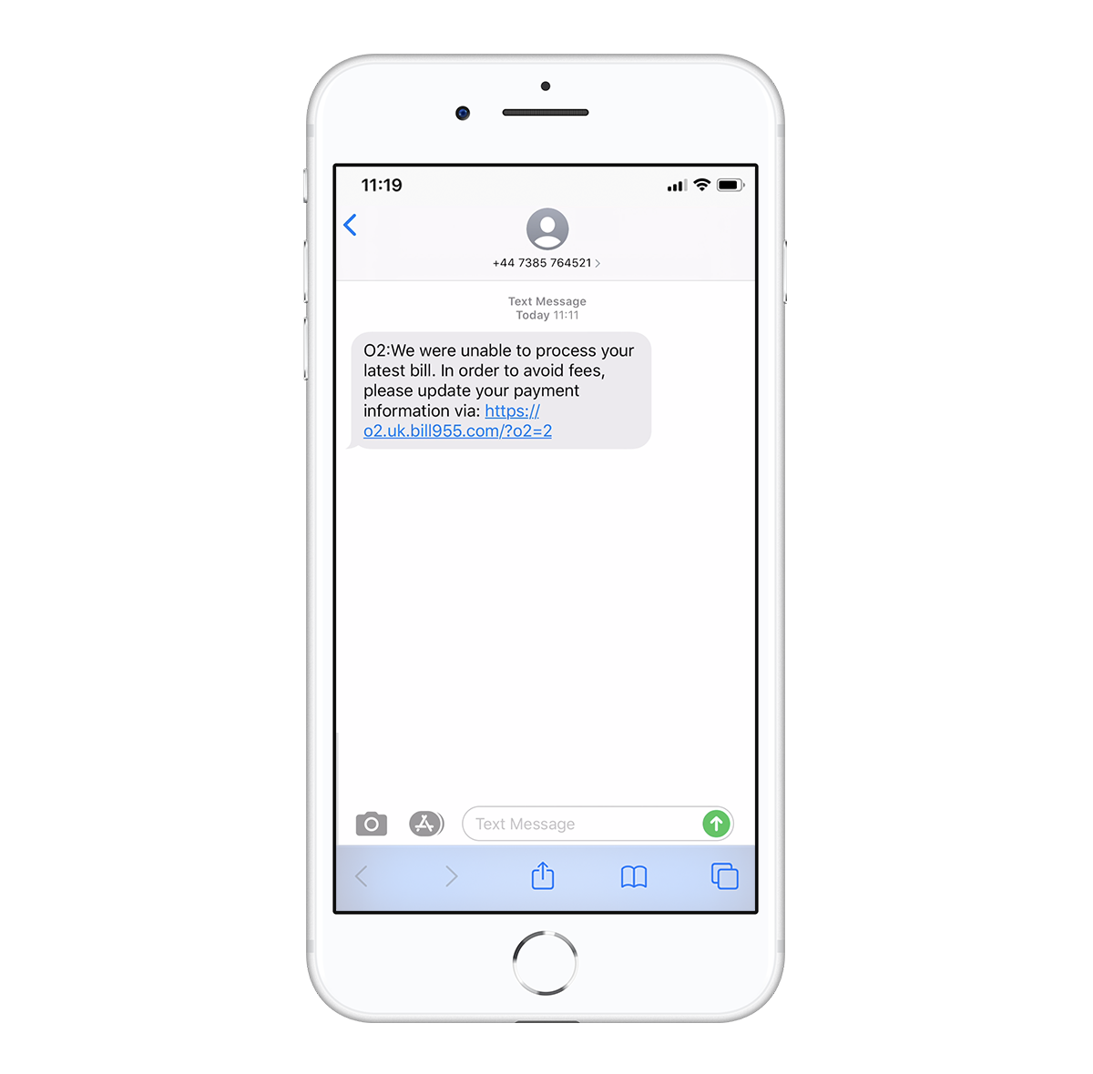
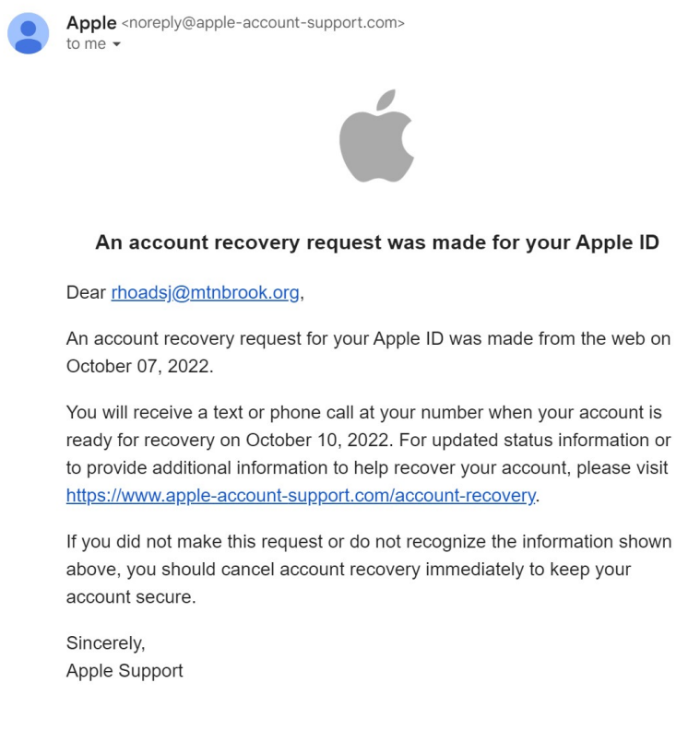
Examples
If a message is coming from a lengthy and/or suspicious looking email address, it is possibly a scam. If a phone number is not a regular 10-digit number, it may be a fake text message.
If the text message or email contains a suspicious looking link, it is probably a scam.

Slide 46
Things to Remember
No government agency will request payment via a gift card. Most official government requests will come via the mail.

Slide 47
As a rule, don’t give out personal information.
Don’t click on links unless you’re absolutely sure of where they will take you.

Slide 48
Don’t respond via phone numbers and email addresses provided in questionable correspondence.
Verify any action requested by a company or person by using a published number or email address.
Don’t trust caller ID.
Educate your elderly family members.

Slide 49
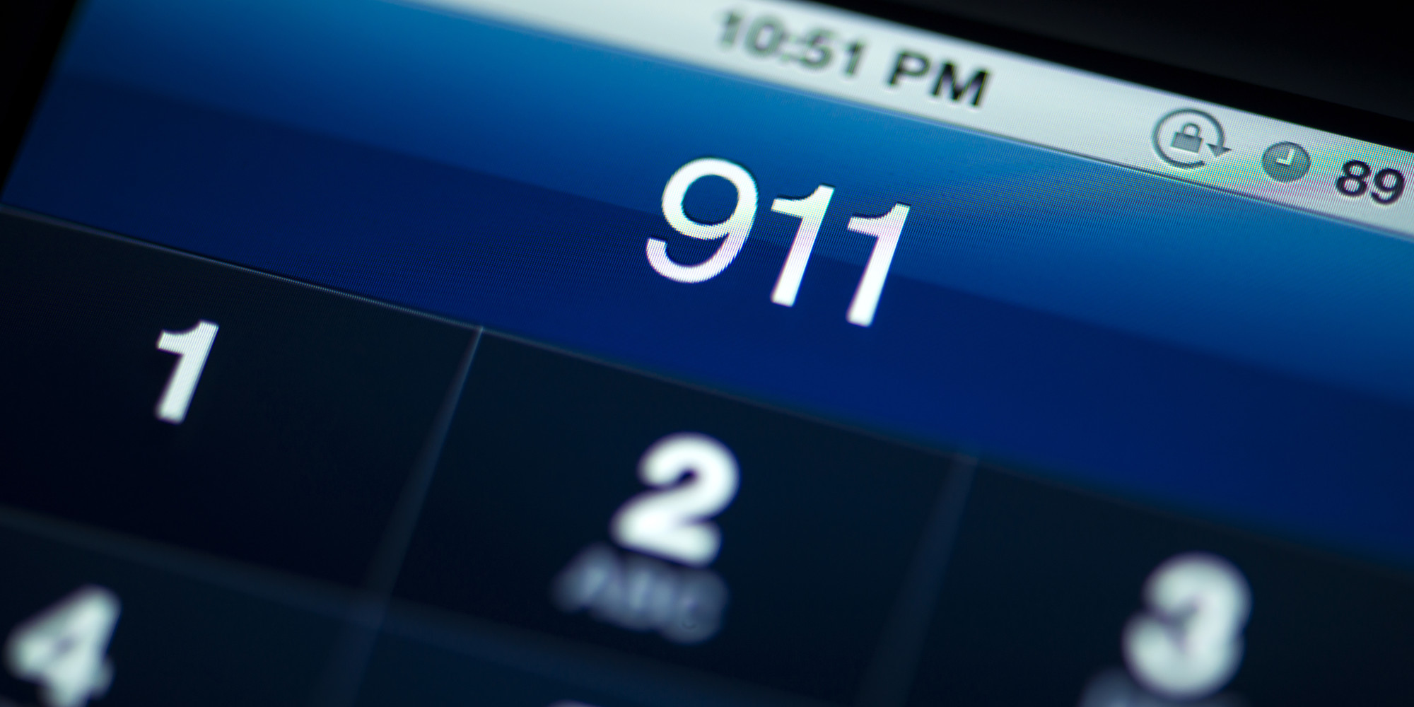
If you become a victim of identity theft or a scam; call the police, put a fraud alert on your credit report and visit www.identitytheft.gov.

Slide 50
Holiday Shopping Safety
Stay aware and alert of what’s going on around you at all times, especially while at ATMs.
Shop during daylight hours when possible.
If you must go at night, go with a friend or family member.
Carry your purse close to your body. Carry your wallet in your front pants pocket or coat pocket.
Limit the amount of cash and number of credit cards you carry with you.

Slide 51
Double check that you have your credit cards and wallet after paying for items
If you’re shopping with children, talk to them ahead of time about what to do if they get lost in the crowd.

Slide 52
Park in a well-lit area.
Visibly scan the lot for any suspicious activity before going to your car.
Have your keys in hand when approaching your vehicle.
Keep your cell phone handy in case you need to call 911.
If you discover someone following you, go back inside the store.

Slide 53
Intentionally set your car alarm off in you need to call attention to yourself.
Check in the back seat and area around your car before getting in.
Once you have entered your vehicle, buckle your seat belt, lock your doors and exit the lot.
When stopped in traffic, leave enough room between your car and the one in front of you in the event you need to pull away quickly.
As you travel home, make sure no one is following you.

Slide 54
Online Shopping
Use secure websites for purchases. Look for “https” and a green padlock.
Make sure you’re dealing with a legitimate company. Double check the URL.
If a deal looks too good to be true, it is probably not legitimate.
Check the authenticity of sales and deals by going to the company’s official website. Don’t trust pop-ups, emails and or text messages.

Slide 55
Don’t disclose personal information.
Realize that profiles are fictitious. Looks for slim profiles without much substance.
Try to meet in a public place and take a friend with you.
Use small amounts of cash or instant electronic transfers at the time of exchange. Use anonymous payment apps like Venmo, Paypal or Zelle.
Stick to local listings.
Consider the credibility of the listing. Does it sound too good to be true?
Limit high value transactions on these type of platforms.
Ways to Stay Safe Using Marketplace

Slide 56
Protecting Package Deliveries from Porch Pirates.
Invest in doorbell cameras
Get packages delivered to your workplace.
Require a signature upon delivery.
Set up notifications and track packages.
Have packages delivered to a package locker facility or invest in a smart package delivery box.

Slide 57
Be wise. Don’t advertise.
Compress boxes from expensive items received and put them in containers or black garbage bags for pick up.

Slide 58
Be alert.
Stay Safe.
Call us if you need us.
Happy Holidays!

Slide 59
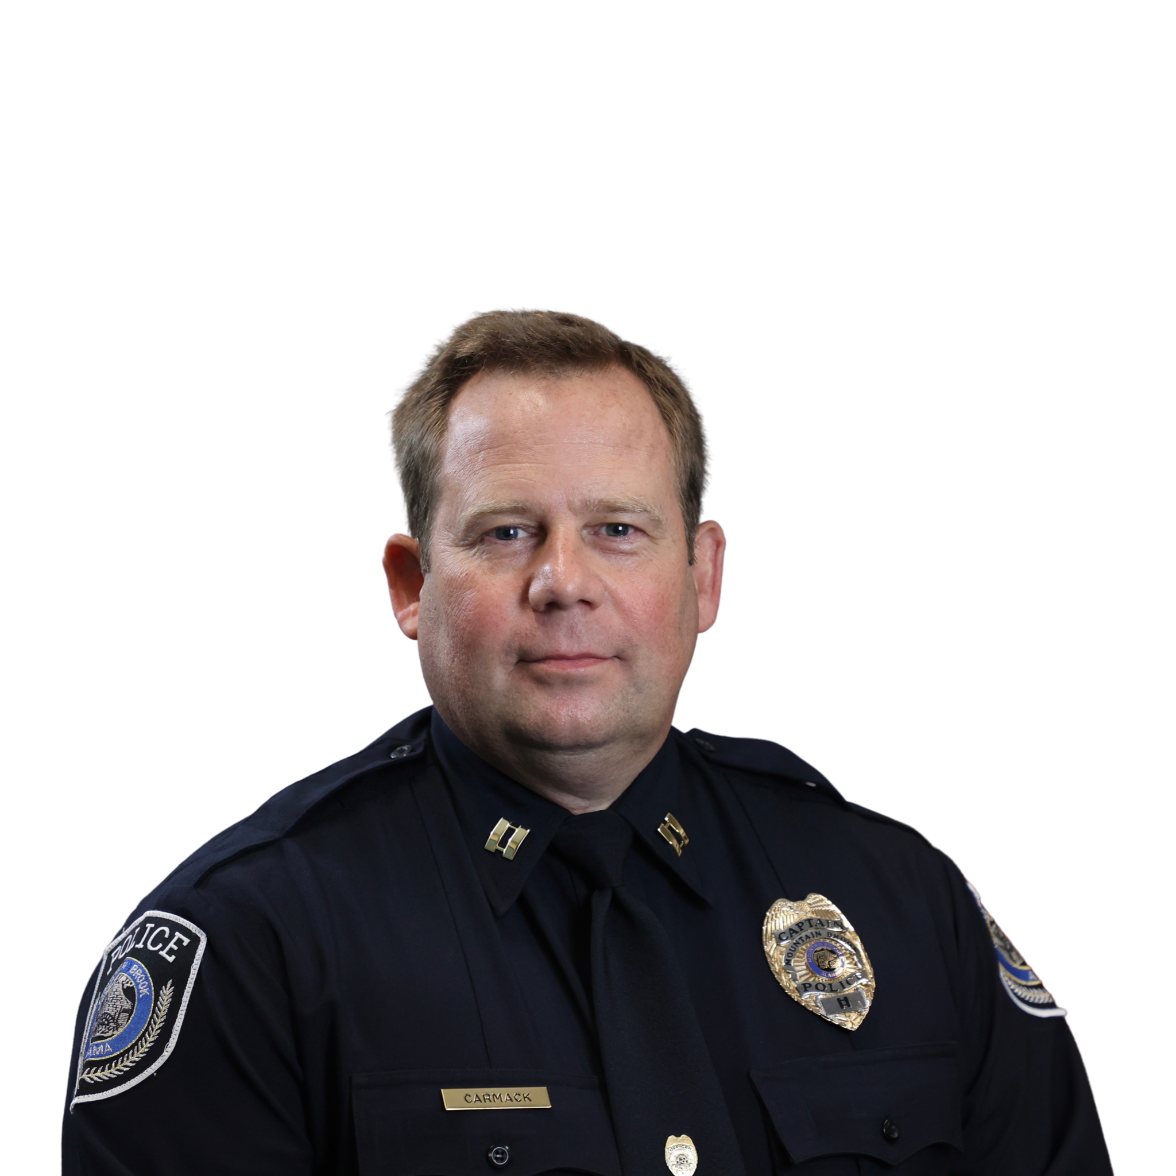
Captain Jason Carmack carmackj@mtnbrook.org 205-802-3858
MOUNTAIN BROOK POLICE DEPARTMENT

