Slide 1
2023 Community Survey City of Mountain Brook, Alabama
Presented by
JUNE 2023

Slide 2
ETC Institute is a National Leader in Market Research
for Local Governmental Organizations
For over 40 years, our mission has been to help city and county governments gather and use survey data to enhance organizational performance.
More Than 2,500,000 Person’s Surveyed Since 2013 for More Than 1,000 Communities in 49 States

Slide 3
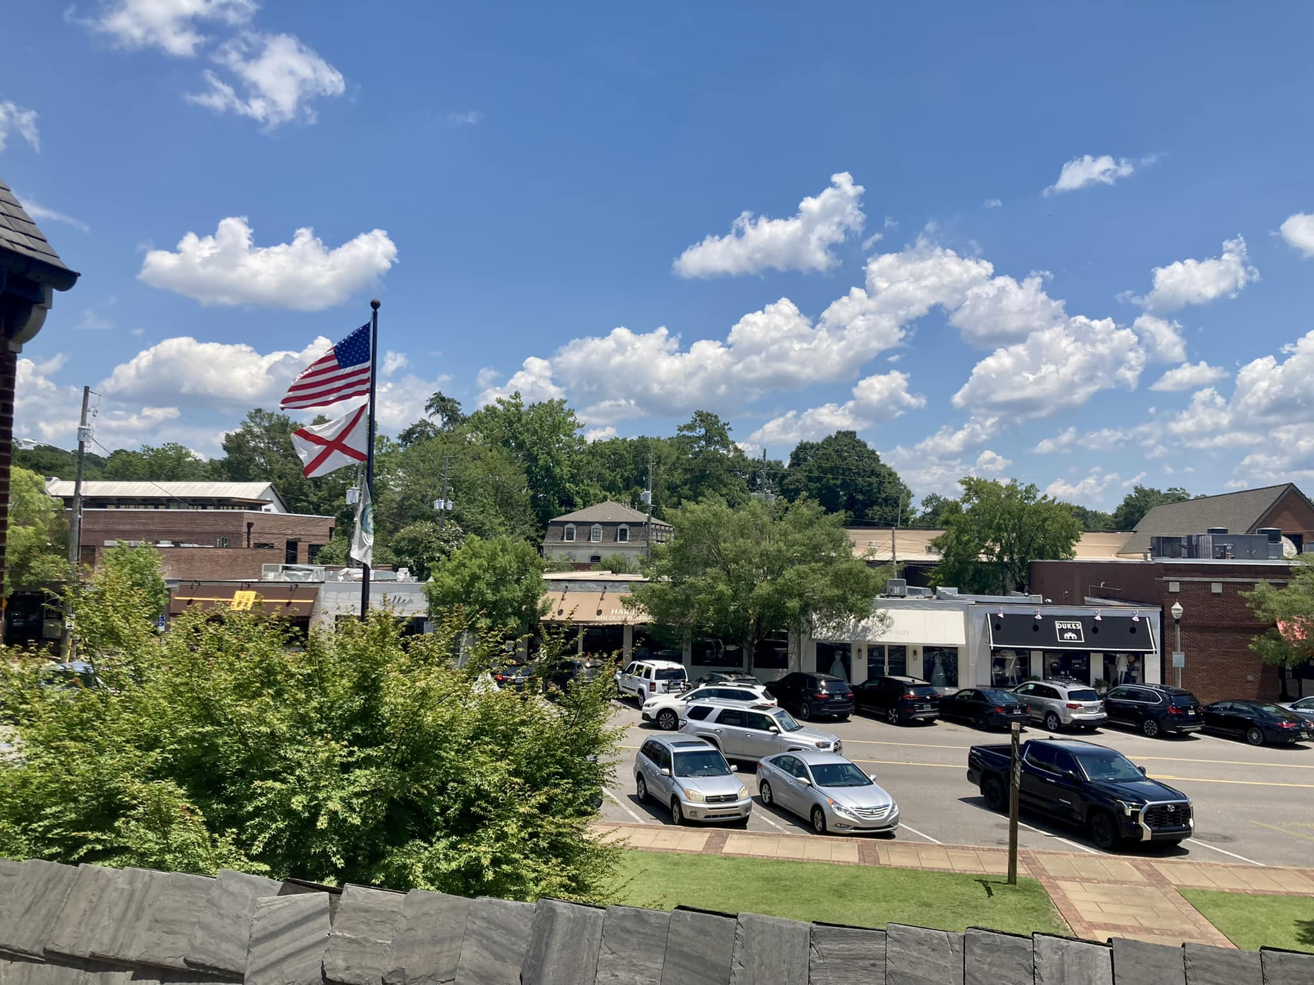
Agenda
Purpose and Methodology
What We Learned
Major Findings
Summary
Questions

Slide 4
Purpose
To objectively assess resident satisfaction with the delivery of major City services
To help determine priorities for the community
To measure trends from previous surveys
To compare the City’s performance with other communities regionally and nationally
4

Slide 5
Methodology
Survey Description
Seven-page survey; included many of the same questions as previous survey
4th Community Survey conducted for the City of Mountain Brook
Method of Administration
By mail and online to randomly selected sample of City residents
Sample Size
417 completed surveys
Margin of error: +/- 4.8% at the 95% level of confidence
5

Slide 6
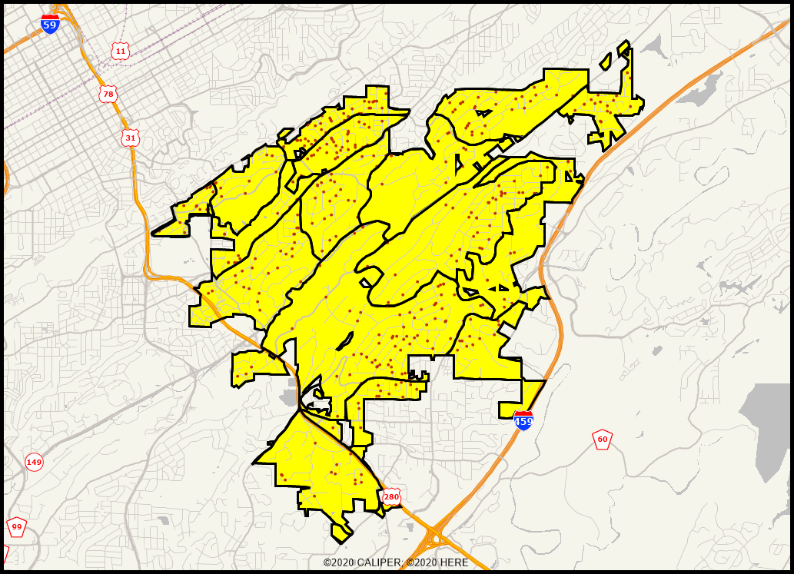
Location of Survey Respondents
Good representation throughout the City
Demographics of survey respondents track closely with the actual population of the City
6

Slide 7
Residents Have a Very Positive Perception of the City of Mountain Brook
What We Learned
100% Rated Mountain Brook as an Excellent or Good Place to Live
99% Rated Mountain Brook as an Excellent or Good Place to Raise Children
Satisfaction Ratings Are Similar to Previous Years, and Remain Among the Highest in the Nation

Slide 8
Satisfaction with City Services Is Much Higher in Mountain Brook Than Other Cities
What We Learned
Mountain Brook Rated Above the U.S. Average in All 43 Areas
Satisfaction with the Overall Quality of City Services Rated 46% Above the U.S. Average
Satisfaction with Customer Service from City Employees Rated 52% Above the U.S. Average
Top Overall Priorities for City Services
Maintenance of City Streets and Facilities
Traffic Flow and Congestion Management

Slide 9
Topic #1
Residents Have a Very Positive Perception
of the City
9

Slide 10
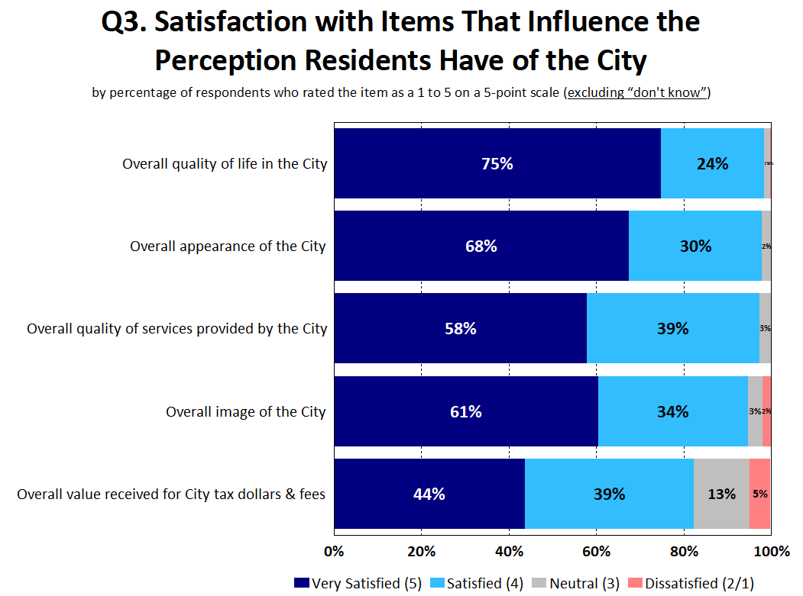
99% Are Satisfied with the Overall Quality of Life in the City
97% of Respondents Are Satisfied with the Overall Quality of City Services
10

Slide 11
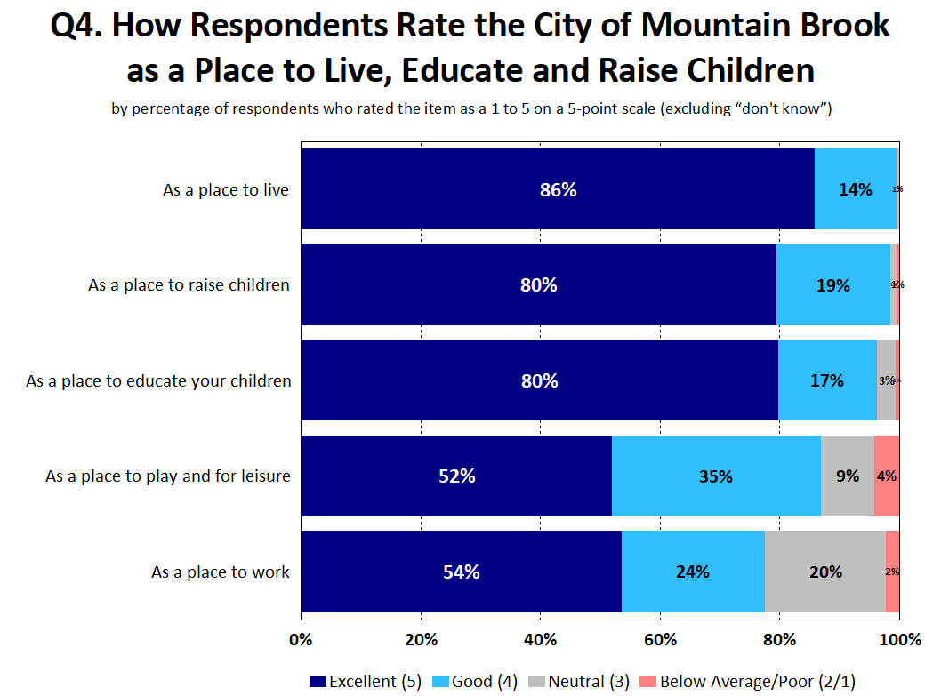
Nearly All Respondents Rated Mountain Brook as an Excellent or Good Place to Live and Raise Children
11

Slide 12
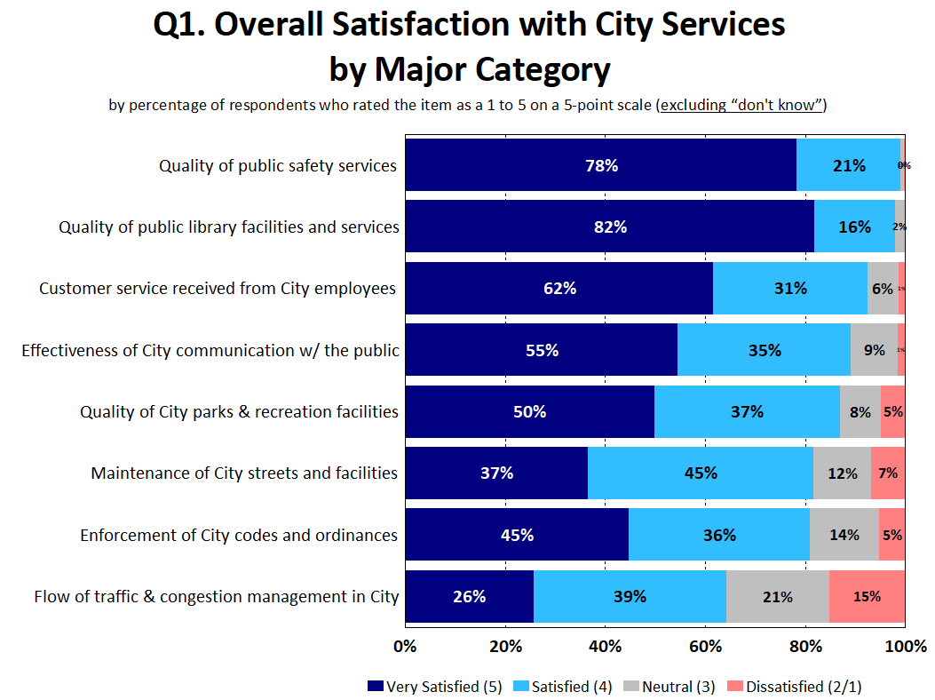
City Services Received High Satisfaction Ratings
12

Slide 13
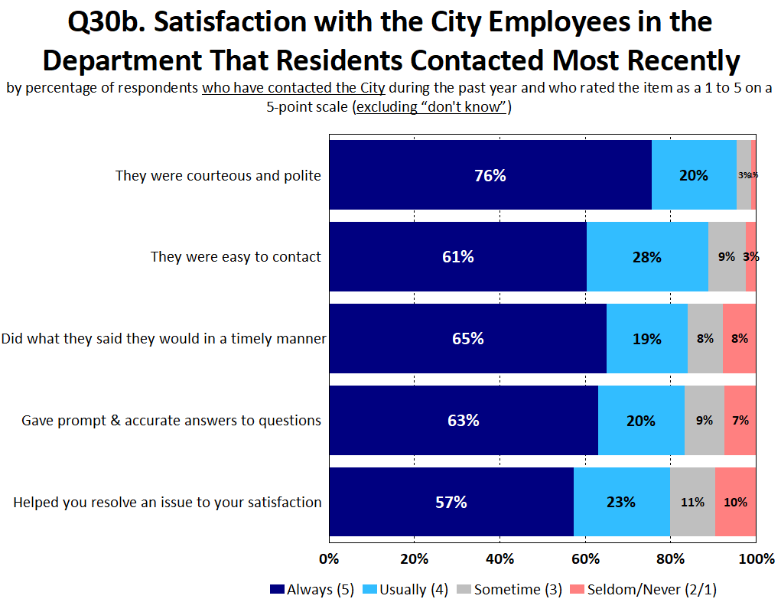
Residents Have Had Positive Interactions with City Employees
13

Slide 14
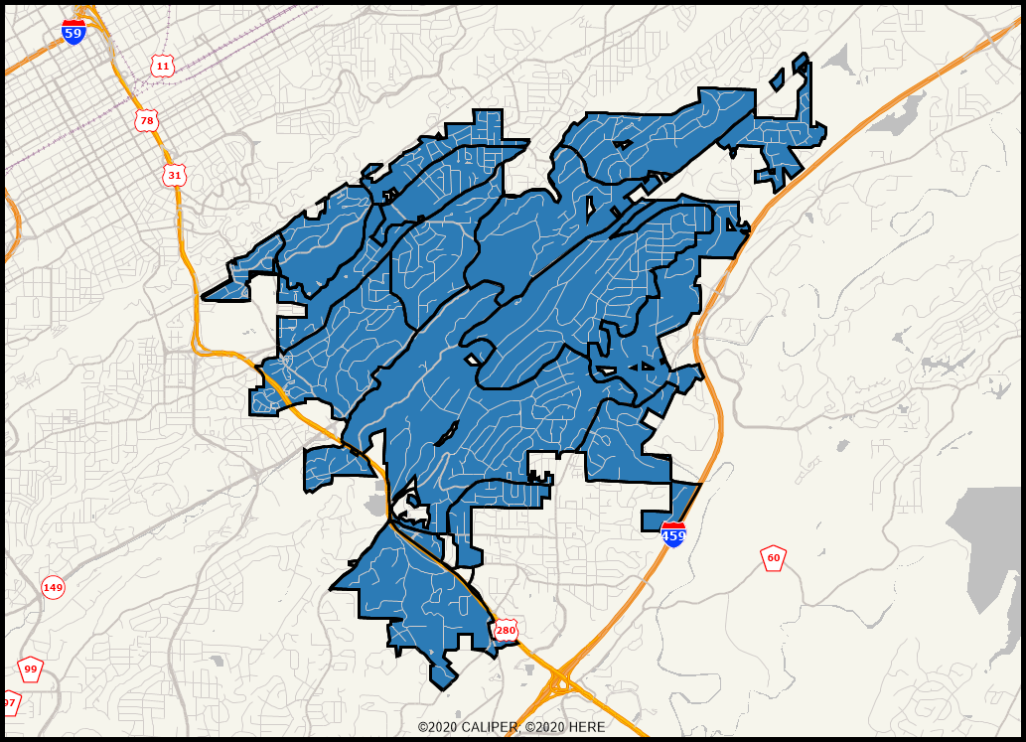
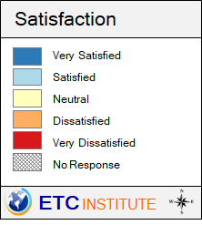
Overall Quality of City Services All Areas Are in Blue, Indicating That Residents in All Parts of the City Are Satisfied with the Overall Quality of City Services
14

Slide 15
Topic #2
Satisfaction with City Services Is Much Higher in Mountain Brook Than Other Communities
15

Slide 16
Benchmarking Analysis
Mountain Brook Rated Higher Than the U.S. Average in All 43 Areas
Mountain Brook Rated Significantly Higher (5% or more) Than the U.S. Average in 42 of the 43 Areas
16

Slide 17
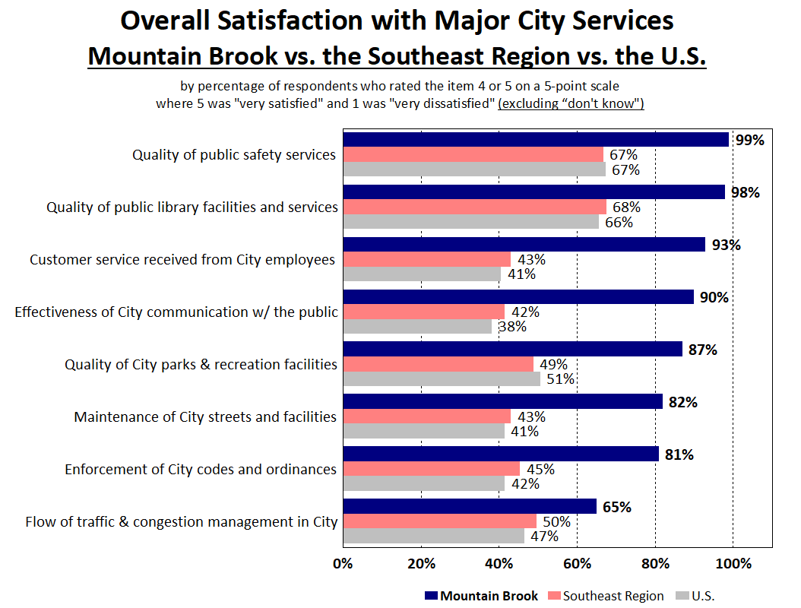
Communication with the Public Rated 52% Above the
U.S. Average
Customer Service from City Employees Rated 52% Above the U.S. Average
17

Slide 18
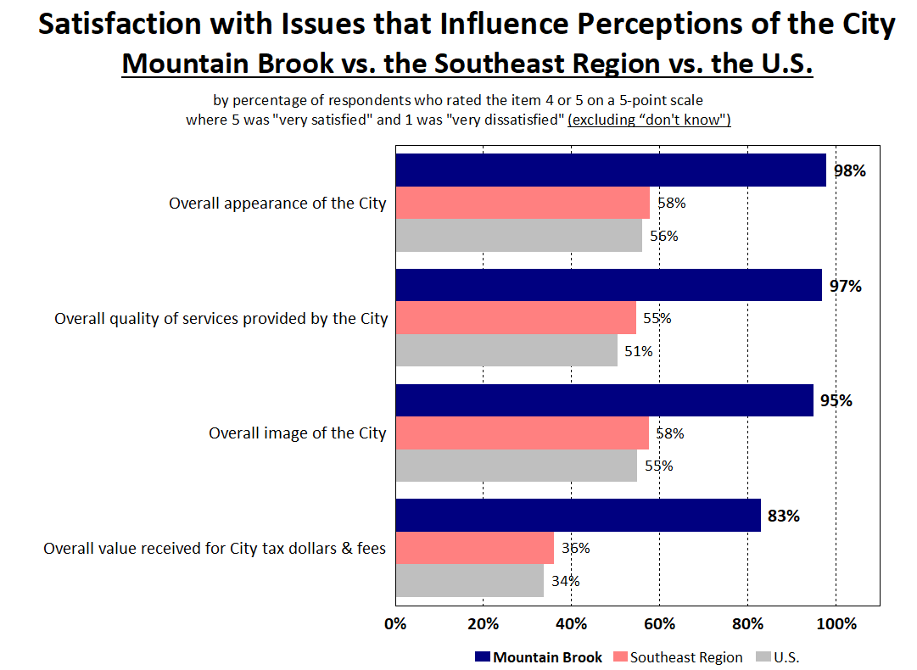
Value Received for City Tax Dollars Rated 49% Above the U.S. Average
The Overall Quality of City Services Rated 46% Above the U.S. Average
18

Slide 19
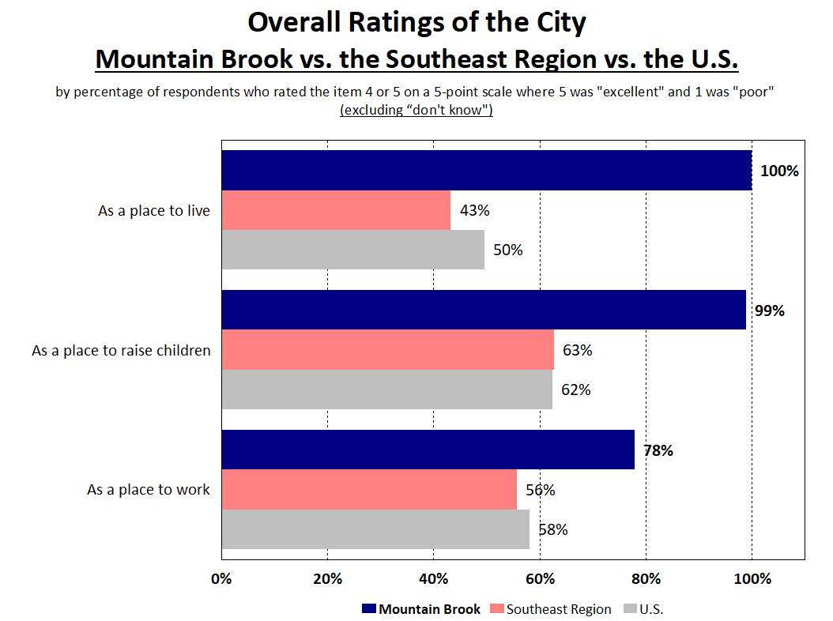
Nearly All Residents Rated Mountain Brook as an Excellent or Good Place to Live and Raise Children
19

Slide 20
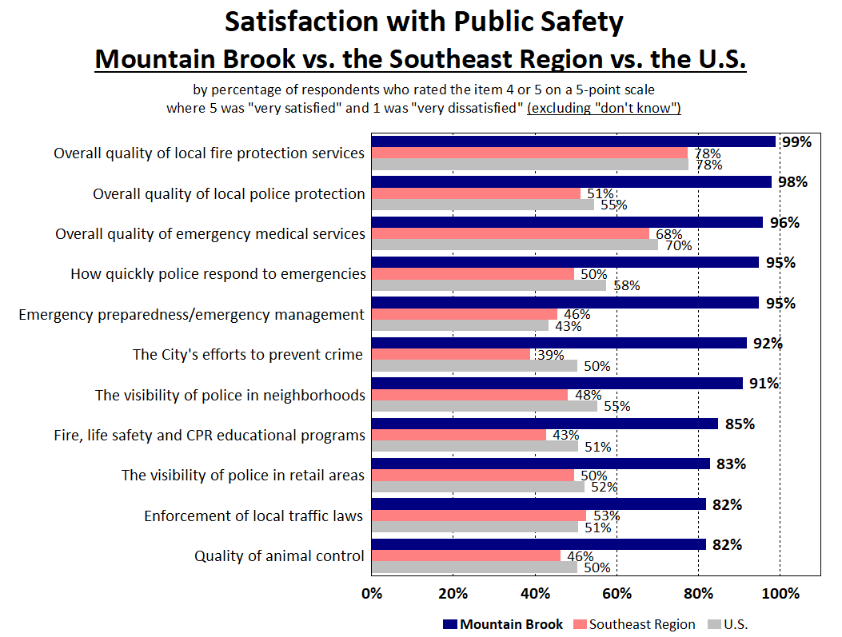
Mountain Brook Rated More Than 30% Above the National Average in All 11 Areas of Public Safety
20

Slide 21
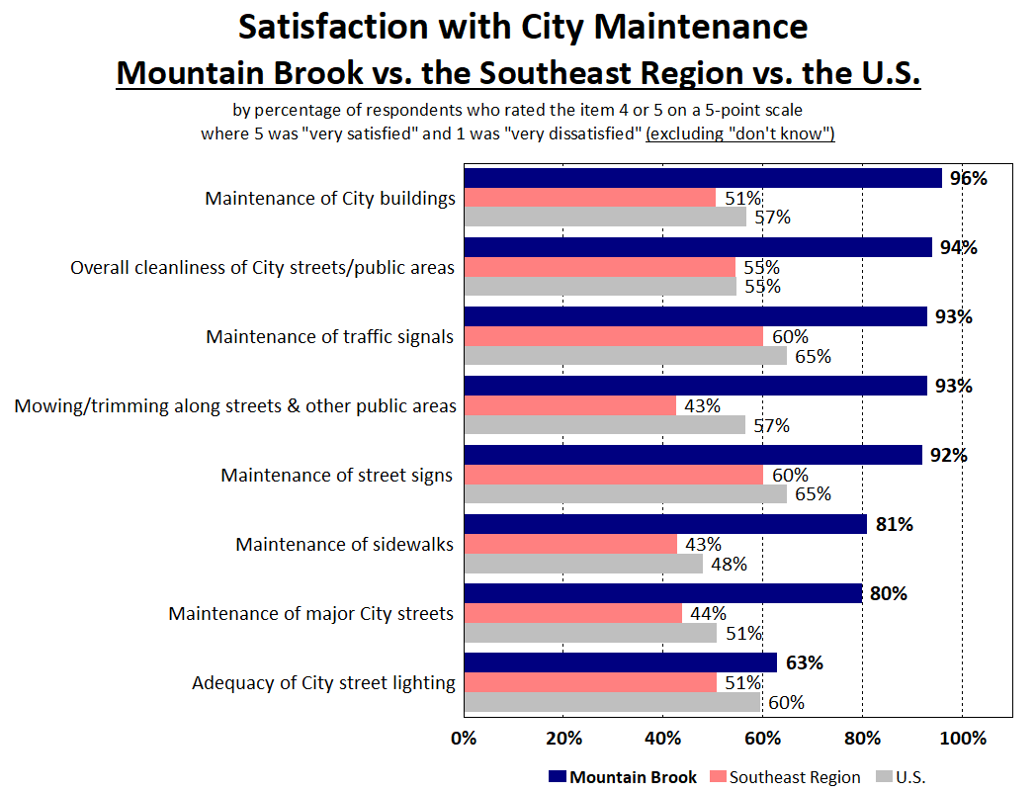
Mountain Brook Rated Significantly Above the National Average in 7 of 8 Areas of Maintenance
21

Slide 22
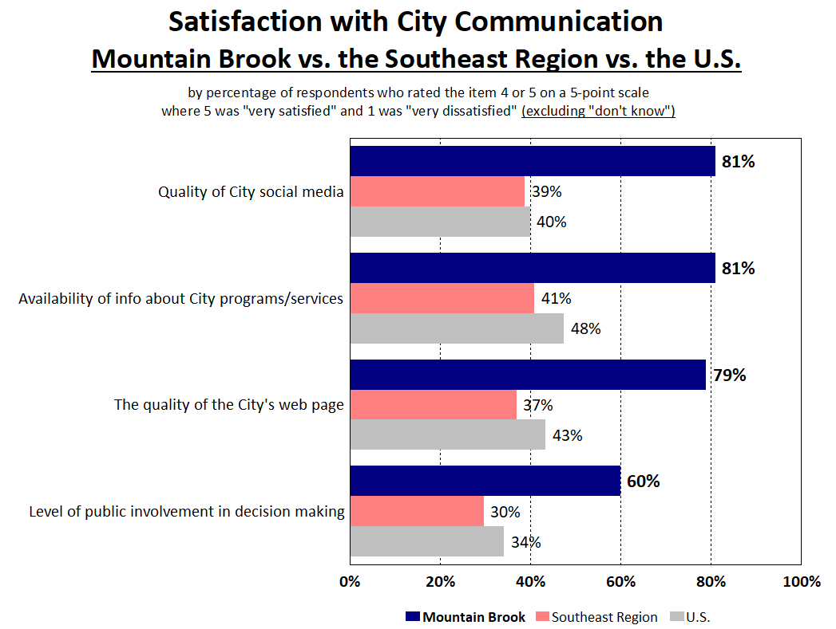
Mountain Brook Rated More Than 25% Above the National Average in All 4 Areas of Communication
22

Slide 23
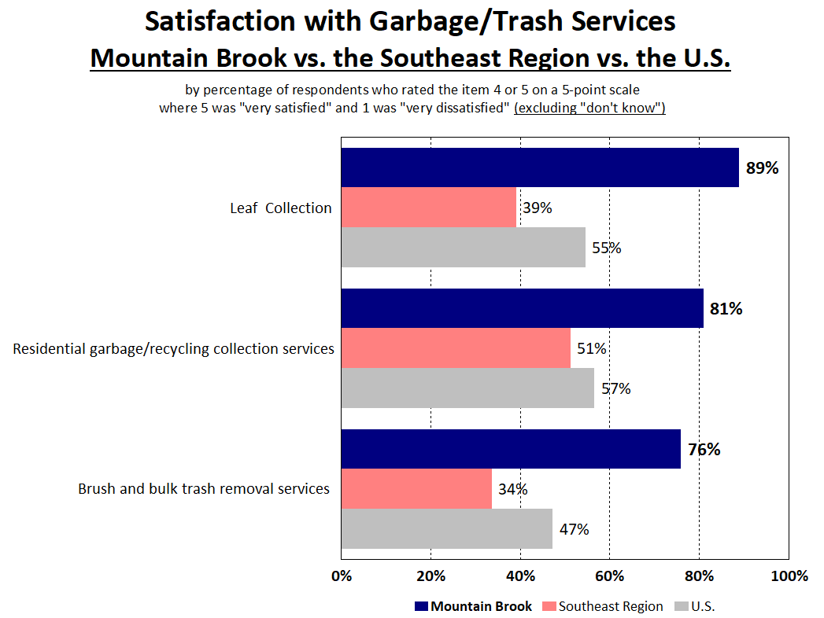
Mountain Brook Rated More Than 25% Above the National Average in All 3 Areas of Trash Services
23

Slide 24
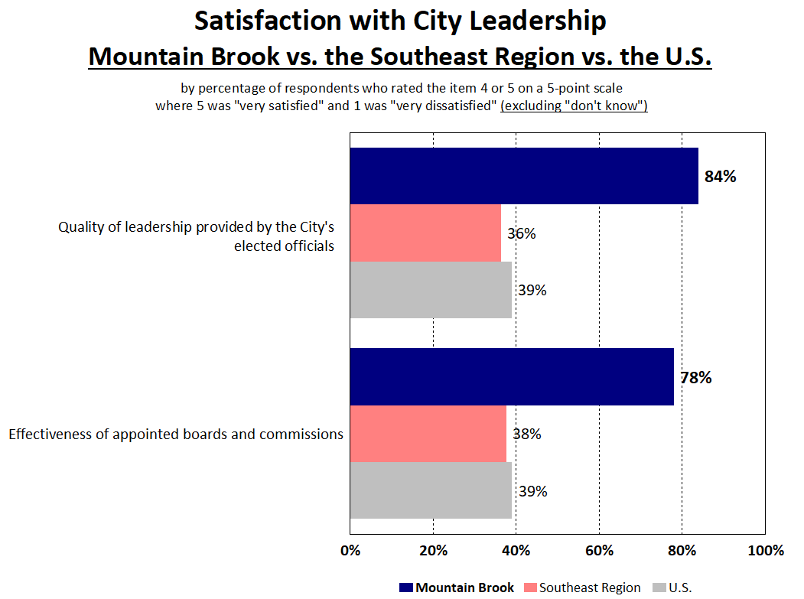
Mountain Brook Rated Significantly Above the National Average in Both Aspects of City Leadership
24

Slide 25
Topic #3
Satisfaction Ratings Are Similar to Previous Surveys
25

Slide 26
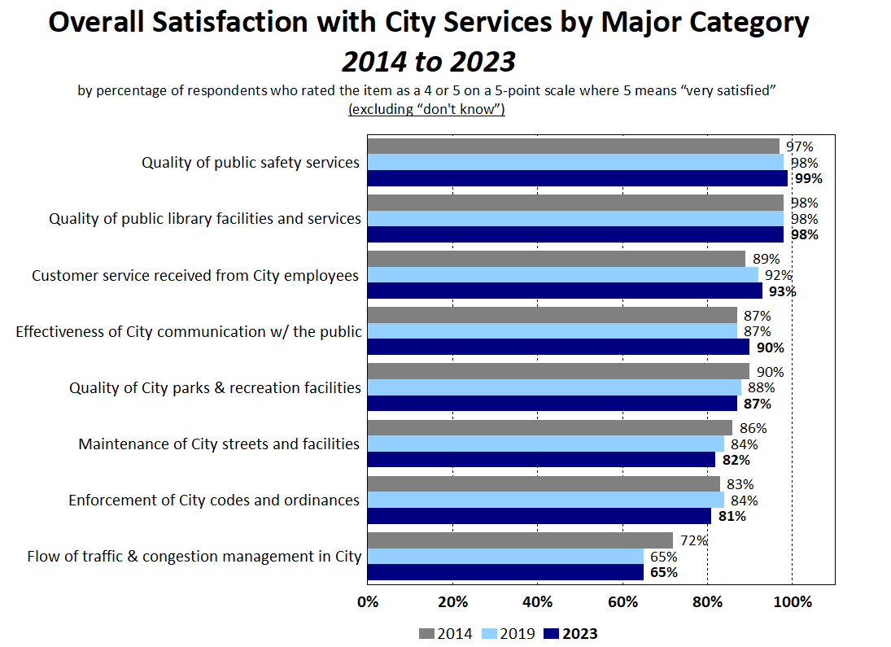
26

Slide 27
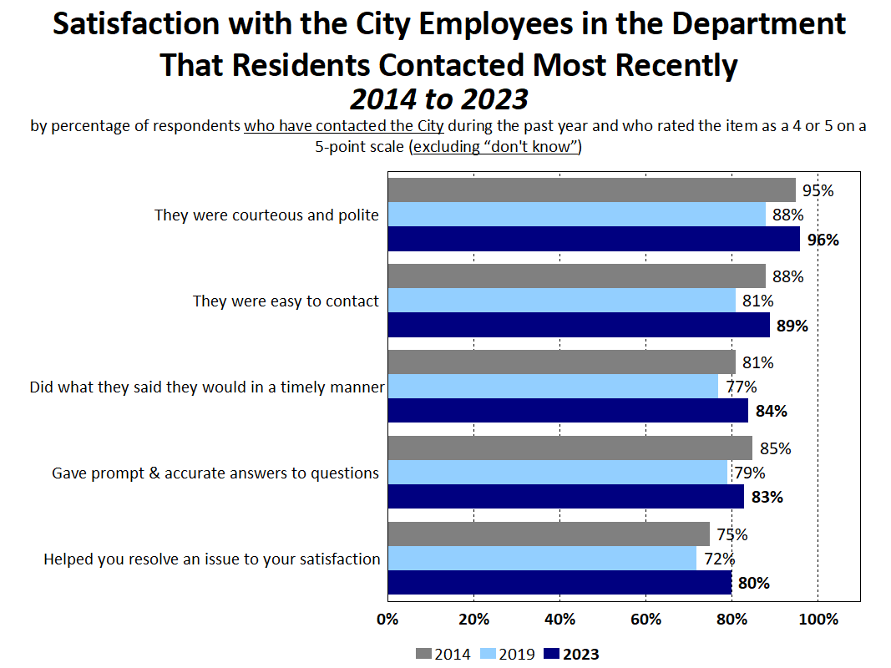
Satisfaction Has Increased in All 5 Areas of Customer Service Since 2019
27

Slide 28
Trend Analysis
Notable Increases in Satisfaction Since 2019:
Quality of City Social Media
City Employees Were Courteous and Polite
City Employees Were Easy to Contact
City Employees Resolved Residents’ Issue to Their Satisfaction
Quality of the City’s Web Page
Notable Decreases in Satisfaction Since 2019:
Brush and Bulk Trash Removal Services
Streaming Music
Digital Magazines
Music CD’s
Streaming TV and Movies
28

Slide 29
Topic #4
Top Priorities
29

Slide 30
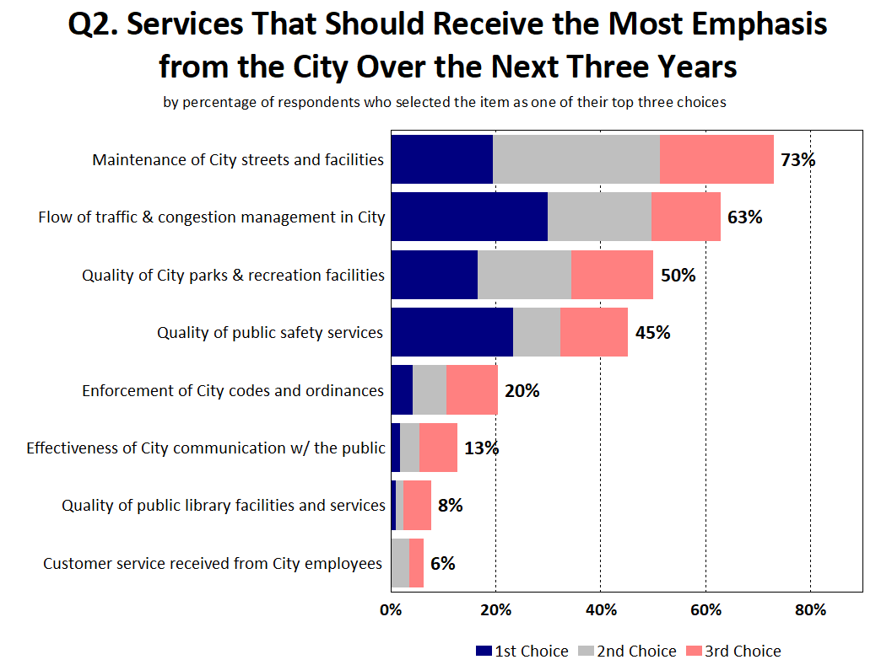
30

Slide 31
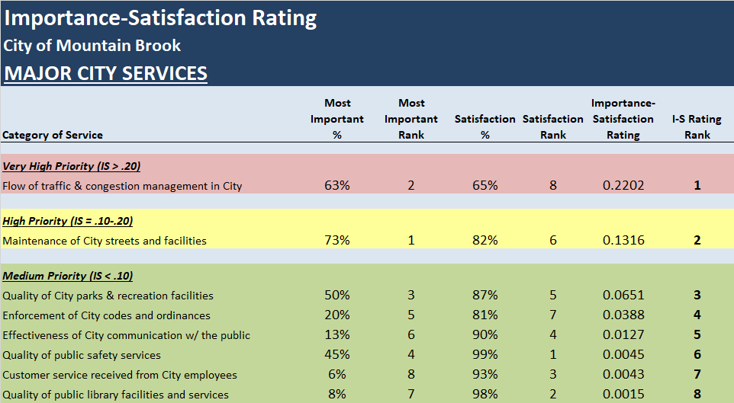
Overall Priorities
31

Slide 32
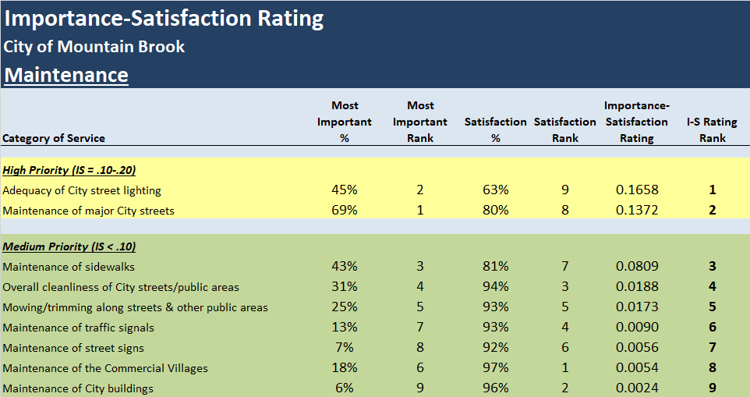
Maintenance Priorities
32

Slide 33
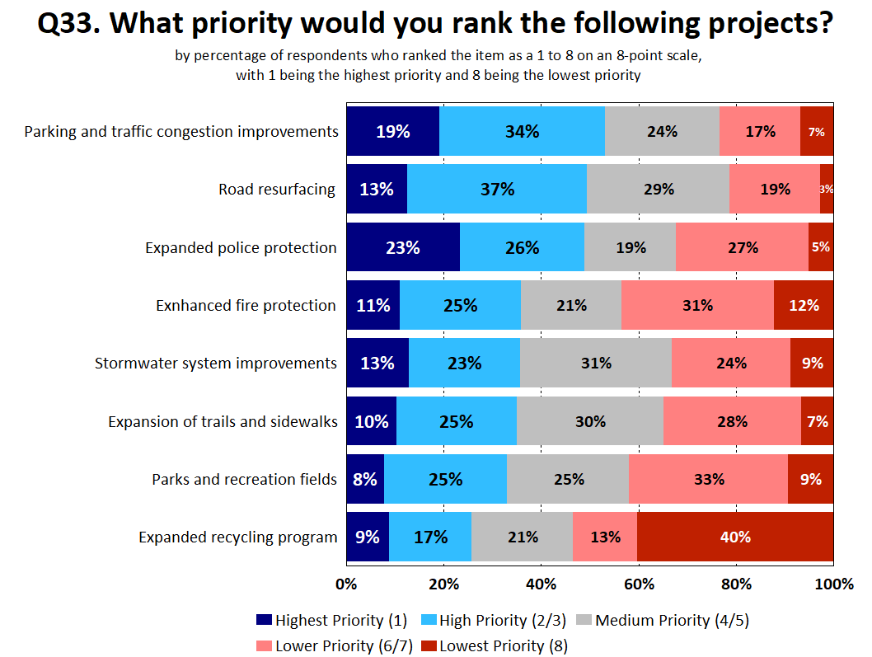
33

Slide 34
Residents Have a Very Positive Perception of the City of Mountain Brook
Summary
100% Rated Mountain Brook as an Excellent or Good Place to Live
99% Rated Mountain Brook as an Excellent or Good Place to Raise Children
Satisfaction Ratings Are Similar to Previous Years, and Remain Among the Highest in the Nation

Slide 35
Satisfaction with City Services Is Much Higher in Mountain Brook Than Other Cities
Summary
Mountain Brook Rated Above the U.S. Average in All 43 Areas
Satisfaction with the Overall Quality of City Services Rated 46% Above the U.S. Average
Satisfaction with Customer Service from City Employees Rated 52% Above the U.S. Average
Top Overall Priorities for City Services
Maintenance of City Streets and Facilities
Traffic Flow and Congestion Management

Slide 36
Questions?
Thank You!!
36

